Slide 1
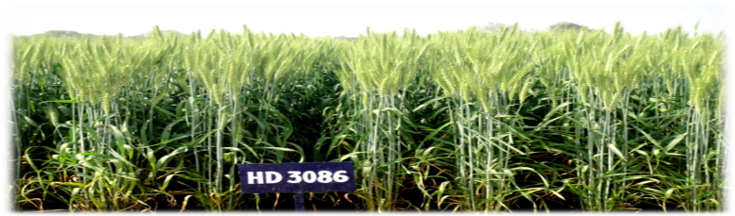
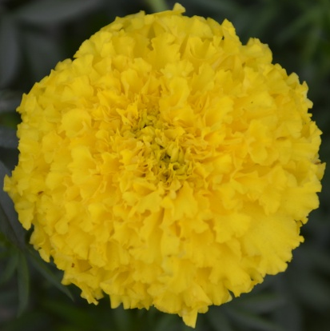
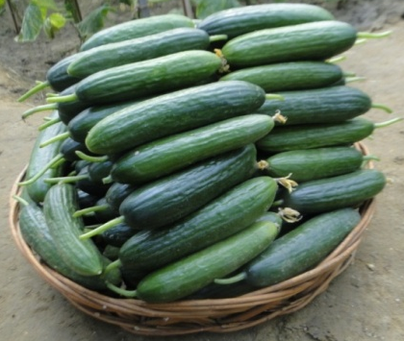
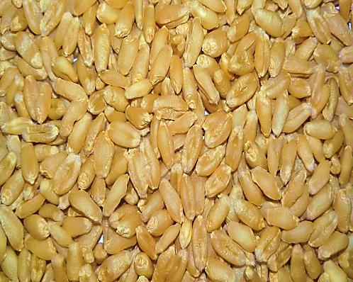
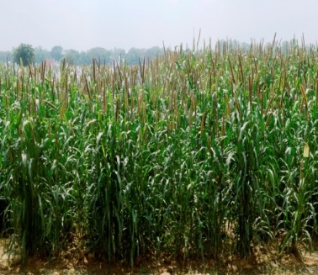
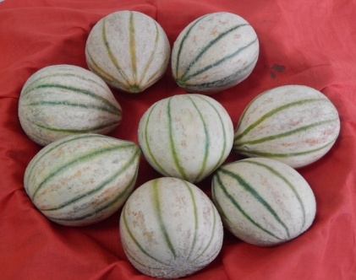
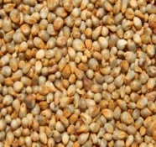
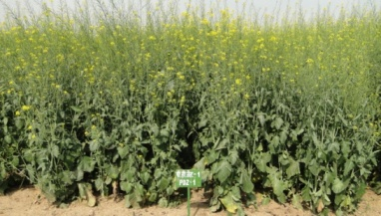
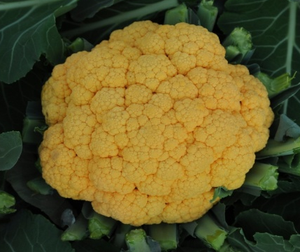
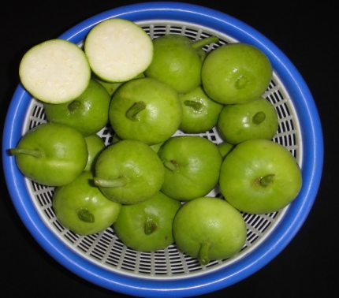
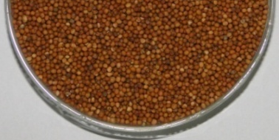


I
CAR-IARI
Varieties Released and Identified
During 2015
54rd Convocation, IARI - 2016

Slide 2
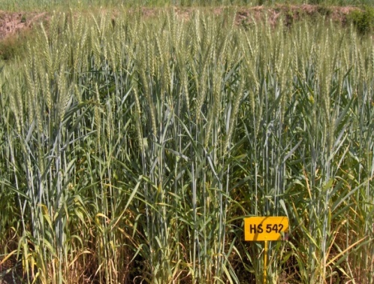
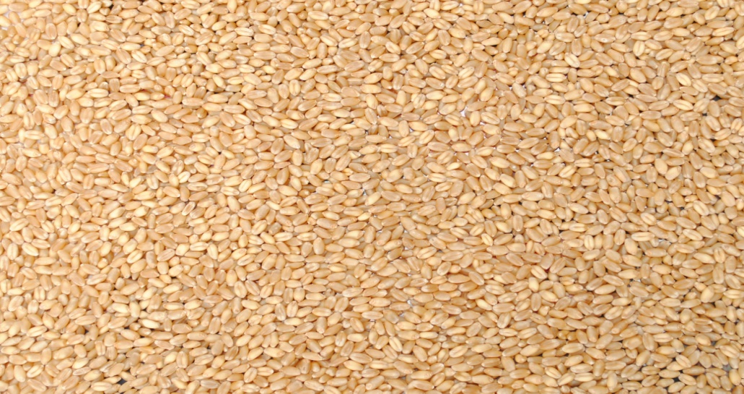
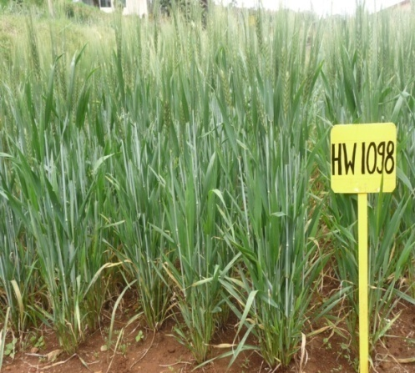
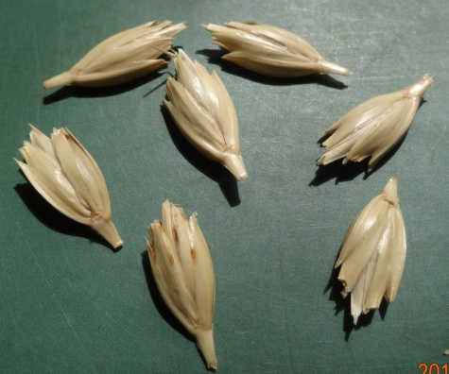
Wheat: HS 542 (Pusa Kiran)
Year of release | : | 2015
Recommended areas | : | North Eastern Hills
Production conditions | : | Early sown rainfed
Average yield | : | 3.3 t/ha
Characteristics | : | A semi-dwarf variety with grain yield potential of 6.03 t/ha under rain fed situations. HS 542 has good chapatti and bread making qualities. The variety is resistant to stripe and leaf rust
Wheat: HW 1098 (Nilgiri Khapli)
Year of release | : | 2015
Recommended areas | : | Dicoccum growing regions of India
Production conditions | : | Timely sown irrigated
Average yield | : | 4.55 t/ha
Characteristics | : | A high yielding, semi-dwarf (85 cm) dicoccum wheat variety with yield potential of 4.78 t/ha and high degree of resistance to stem, leaf and yellow rust. HW 1098 produced bold grain (40.3g), with better grain quality (>13% protein and 3.7 ppm β carotene)

Slide 3
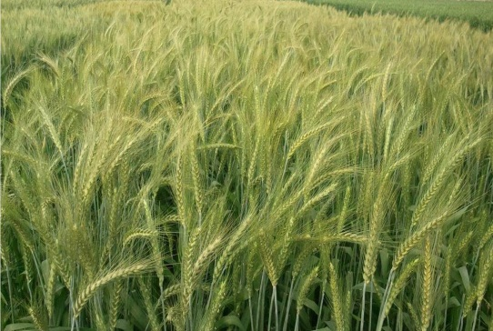
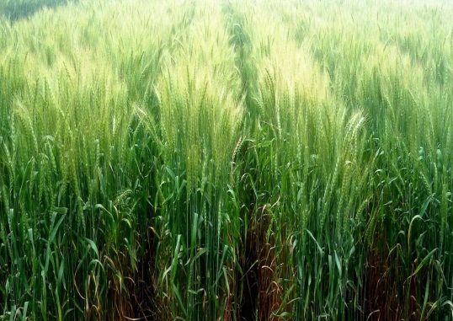
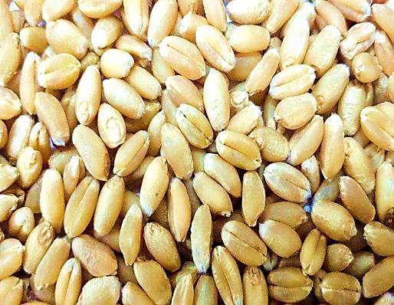
Wheat: HDCSW 18
Year of release | : | 2015
Recommended areas | : | NCR/Delhi state
Production conditions | : | Early sown irrigated conditions under conservation agriculture (CA) environment
Average yield | : | 6.28 t/ha
Characteristics | : | This is the first variety of the country bred specifically for CA. It has genetic yield potential of more than 7t/ha. It out yielded the checks like HD 2967, PBW 550 and DBW 17 under CA by 11.13 to 20.74 % in NCR. It is resistant to high temperature at seedling stage. It escape high temperature at maturity due to early seeding. It is highly resistant to brown rust and has lower incidence of Karnal bunt.
Wheat: HD 3117
Year of release | : | 2015
Recommended areas | : | NCR/Delhi state
Production conditions | : | Late sown irrigated conditions under conservation agriculture (CA) environment
Average yield | : | 4.7 t/ha
Characteristics | : | It has genetic yield potential of 5.5 t/ha. Average yield of this variety under late sown (after 15 th Dec.) is 4.78 t/ha under tilled condition and 4.79 t/ha under conservation agriculture condition. It is free from brown and yellow rust under natural condition and highly tolerant to Karnal bunt. Grain protein content is 11.7 %.

Slide 4
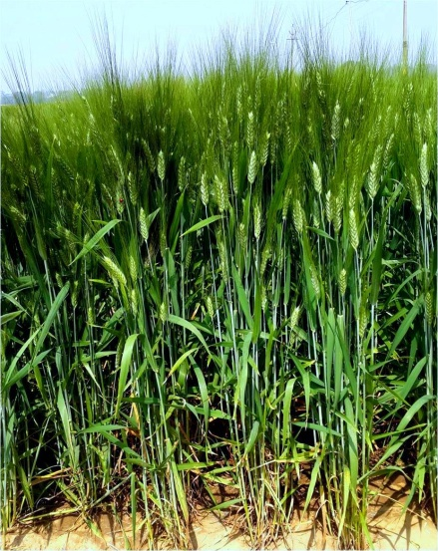
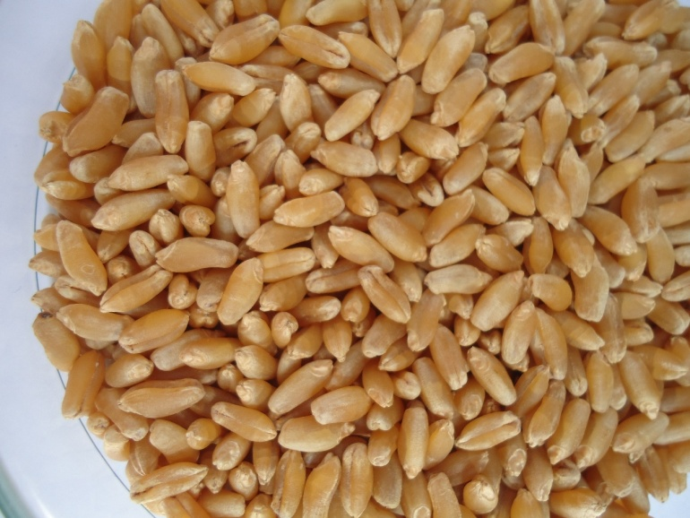
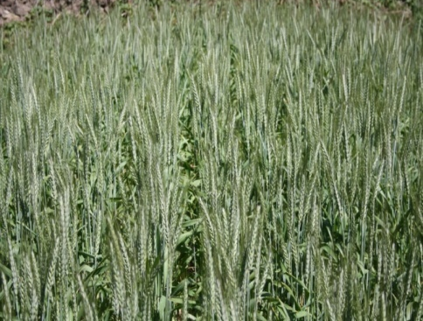
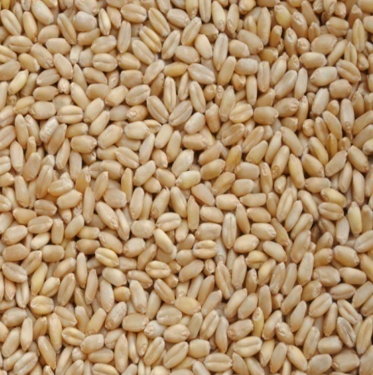
Wheat: HD 4728 (Pusa Malvi)
Year of Identification | : | 2015
Recommended areas | : | Central Zone
Production conditions | : | Timely sown irrigated
Average yield | : | 5.42 t/ha
Characteristics | : | A semi-dwarf (90 cm), 120 days maturing durum wheat variety with genetic yield potential of 6.8 t/ha. The variety has high degree of resistance to leaf and stem rust diseases. Its has bold and lustrous grains and superior quality traits for end-use in semolina-based industry
Wheat: HS 562
Year of Identification | : | 2015
Recommended areas | : | Northern Hill Zone
Production conditions | : | Timely-Sown-Rainfed & Irrigated
Average yield | : | Rainfed condition: 3.6 t/ha Irrigated condition: 5.2 t/ha
Characteristics | : | It has genetic yield potential of 6.2 t/ha under irrigated condition. It has shown good levels of field resistance to leaf and stripe rusts and possess good chapatti and bread making qualities.

Slide 5

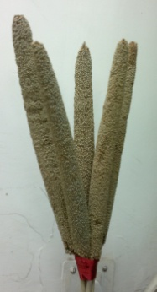
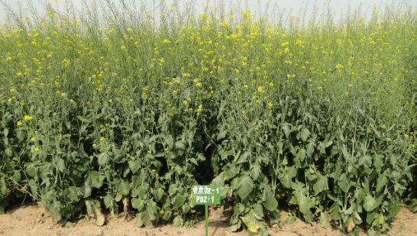

Pearl Millet: Pusa Composite 701
Year of Identification | : | 2015
Recommended areas | : | Zone A:Rajasthan, Haryana and Western Gujarat
Production conditions | : | Timely sown rainfed
Average yield | : | 2.3 t/ha
Characteristics | : | Variety identified for zone A. Pusa composite 701 is a dual purpose pearl millet variety identified for A zone with high grain and stover yields. Pusa composite 701 is high yielding composite variety which showed 6.01 to 25.5 % higher yield over four checks. Resistant to downy mildew and blast
Pusa Double Zero Mustard 31
Year of identification | : | 2015
Recommended areas | : | National Capital Region
Production conditions | : | Timely sown irrigated
Average yield | : | 2.37 t/ha
Characteristics | : | First Canola type (Erucic acid<2% and glucosinolates <30ppm) Indian mustard variety in India Released for timely sown irrigated conditions of NCR It is a yellow seeded variety with 40.56% oil content It matures in 144 days

Slide 6
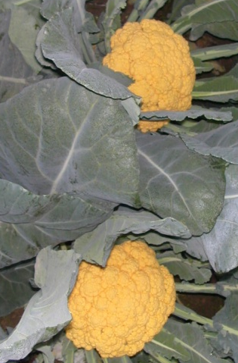
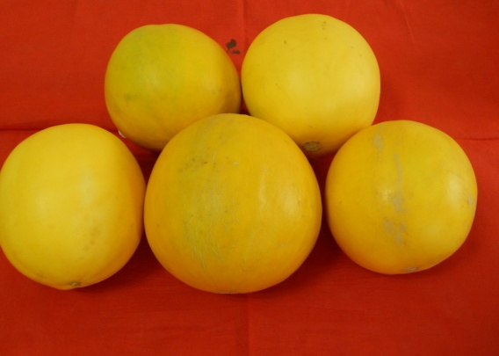
Cauliflower : Pusa Betakesari
Year of identification | : | 2015-16
Characteristics | : | This is the first ever indigenously bred bio-fortified beta carotene (800 – 1000 µg/100 g) rich cauliflower variety, an attempt to tackle beta carotene deficiency related malnutrition problem in India. Its curds are orange coloured, compact and very attractive with semi-self-blanching growth habit. It is suitable for September – January growing period. Average marketable curd weight is about 1.250 kg with an approximate marketable yield of 42.0 – 46.0 t/ha.
Sarda melon : Pusa Sarda
Year of identification | : | 2015-16
Characteristics | : | This is a first variety of Sarda melon which can be grown in net-house under north Indian plains. Its fruit are golden yellow, roundish to elongated globe shaped with average weight of 1.1 kg. Fruits get ready for harvest in about 85-90 days. Fruit flesh is thick, greenish white, and very crispy with high sweetness (TSS 13.6⁰B). It can be stored for 15 to 20 days. Its average yield is 5.44 t/1000 m² under net-house.

Slide 7


Musk melon : Pusa Madhurima
Year of identification | : | 2015-16
Characteristics | : | This is a unique shaped muskmelon variety with high yield (22.45tonnes/ha) and increased shelf life. Its fruit is ovate to obovate shape with average weight of 775 gram. Fruits get ready for harvest in about 80 days. The rind colour of fruit is creamish yellow with green sutures. Fruit flesh is thick, green, juicy and crispy with medium musky flavour and high sweetness (TSS 12⁰Brix). Fruit surface is grooved with moderate netting and is slipable at maturity. Fruits attain nipple shape at peduncle end. Its leaves are weakly lobed and shows andromonoecious sex expression.
Cucumber : Pusa Seedless Cucumber-6
Year of identification | : | 2015-16
Characteristics | : | First extra early (40-45 days for first fruit harvest) improved variety of parthenocarpic gynoecious cucumber suitable for cultivation in protected condition. Fruits are attractive, uniform, dark green, glossy, cylindrical, straight, slightly ribbed, non-hairy, non-warty, slightly striped at blossom end and has tender skin & crispy flesh. Average fruit length, width & weight are 14.24 cm, 3.45cm & 105 g, respectively. Average fruit yield is 126 t/ha (1260 kg/ 100 m²) during winter season (off-season, November-March).

Slide 8
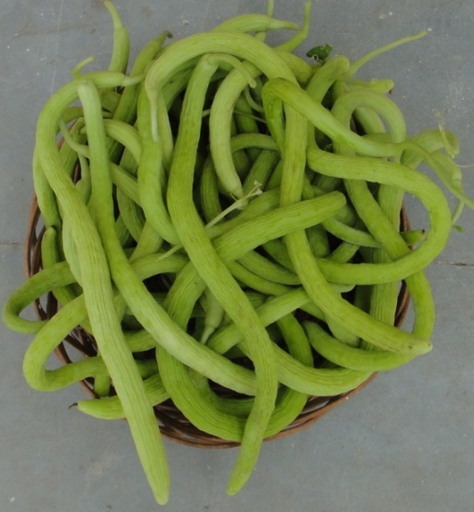

Long melon : Pusa Utkarsh
Year of identification | : | 2015-16
Characteristics | : | First early maturing variety of long melon for spring summer season cultivation under North Indian plains. Fruits sets ready for first harvest in 45-50 days after sowing in spring summer season. Fruits are slightly curved, medium long (length 52 cm), thin (diameter 2.4 cm), light green, smooth non-prominent ridges, shiny with tender skin, crispy flesh, and free from bitterness. Each fruit weighs 130-145g at marketable stage. Seeds light tan in colour. Average fruit yield 29.2 t/ha during spring summer season.
Round melon : Pusa Raunak
Year of identification | : | 2015-16
Characteristics | : | First early maturing variety of round melon for spring summer season cultivation for North Indian plains. Fruits become ready for first harvesting in 55-60 days after sowing. It produces 8-10 fruits per vine. Young fruits at marketable stage are attractive green, shiny, uniform, flattish round in shape, 5 cm in diameter. Flesh is white, tender, less-seeded and has good cooking quality. Each fruit is medium in size and weighs 60 g at marketable stage. The seeds are black in colour with ridged border. Average fruit yield 7.59 t/ha during spring summer season.

Slide 9

Marigold: Pusa Bahar
Year of identification | : | 2015
Characteristics | : | It belongs to African marigold group which flowers in 90-100 days after sowing. Plants are vigorous having height of 75-85 cm. Flowers are compact, flattened, attractive and large in size (8-9 cm) of yellow colour, floriferous producing on an average 50-60 flowers per plant, bloom during extreme winter i.e. in January to March profusely. It is suitable for bedding in gardens as well as other floral decorations.

Slide 10
I
CAR-
I
AR
I

