Slide 1

Welcome

Slide 2

“GENETIC VARIATION AND INTERRELATIONSHIP STUDIES IN F₂ GENERATION OF GROUNDNUT (Arachis hypogaea L.)”
Speaker: -
Patel Chiragbhai Karshanbhai
Reg. No: 2010115061
M.Sc.(Agri.) student
Dept. of Genetics and Plant Breeding
Major Guide:-
Dr. J. H. Vachhani
Research Scientist (Castor)
Main Oilseeds Research Station
Junagadh Agricultural University Junagadh
Minor Guide:-
Dr. V. J. Bhatiya
Professor & Head
Dept. of Seed Science and Technology
& Nodal Officer (Mega Seed)
College of Agriculture
Junagadh Agricultural University
Junagadh

Slide 3

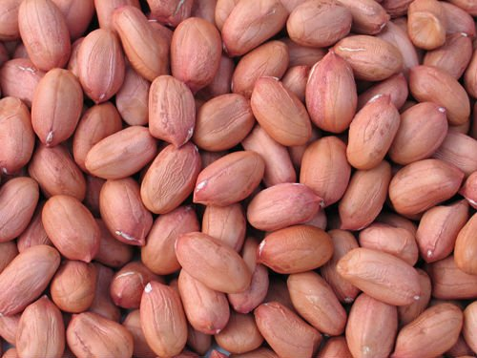
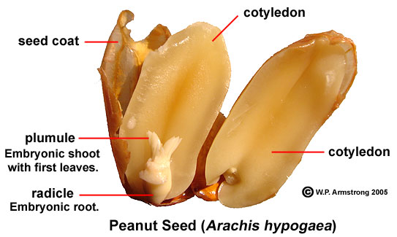
INTRODUCTION
.
Botanical Name | Arachis hypogaea L.
Family | Fabaceae
Chromosome number | 2n = 4x = 40
Origin | South America

Slide 4
INTRODUCTION
Cultivated groundnut (Arachis hypogaea L.) is commonly known as monkeynut, peanut and goobernut, manillanut, earthnut and popularly called as magphooli. Which is one of the principal economic crop of the world, ranking 13th among food crops. It is also first ranking oilseed crop of India. Groundnut is commercially cultivated over 100 countries between latitude 40º N and 40º S.
Cultivated groundnut is a self pollinated, autotetraploid legume crop. Botanically, cultivated groundnut can be classified into two sub-species, which mainly differed in their branching pattern. Each sub-species is again divided into two botanical varieties, sub-species hypogaea into var. hypogaea (Virginia) and var. hirsuta; and sub-species fastigiata into var. fastigiata (Valencia); var. vulgaris (Spanish). In trade, bold seeded types are referred to as Virginia, the small seeded as Spanish and third type runner is also recognized.

Slide 5
Groundnut is a rich source of edible oil (47-54%), high quality protein (22-30%), starch (6-24%), cellulose (1-2 %) and mineral (2-3 %), calories (5-6%). It has a distinct position among the oilseeds as it can be consumed and utilized in diverse ways. It is valued both for edible oil and confectionery purposes. The groundnut kernels are consumed as raw, boiled, roasted or fried products and also used in a variety of culinary preparations like peanut butter, peanut milk and chocolates.
India is largest producer of groundnut. Despite of this fact, it is facing a serious shortage at present in the indigenous supply of vegetable oils. Oil is the component of yield available from groundnut. As indicated above the main use of groundnut is for oil extracting, hence the object of increasing in oil yield. To make the nation self-sufficient in vegetable oil, the poll content in groundnut should be brought to a higher level than the existing one.
Contd…..

Slide 6
AREA, PRODUCTION AND PRODUCTIVITY
Sr. No. | Area (million ha) | Production (million metric tons) | Productivity (metric tons/ha)
World | 23.65 | 39.41 | 1.67
India | 4.60 | 4.90 | 1.07
Gujarat | 3.73 | 4.85 | 1.30
Anonymous, 2015

Slide 7
Practical Utility of Research Problem
Availability of sufficient genetic variability is very important in a crop improvement programme. For successful breeding programme, amount of variability present in the experimental material is a desirable characteristic.
The knowledge of nature and magnitude of genetic variance controlling yield and yield components is very useful for deciding the breeding procedure to be followed for improvement of a crop. Moreover, the selection of superior single plants in segregating generations commences from the F₂ populations. The information on genetic basis of expression of different characters in such populations therefore gives better idea of practicing selection.

Slide 8
Practical Utility of Research Problem
Correlation analysis provides the mutual relationship between various plant characters and determines the component character on which selection can be based for genetic improvement in yield. Path analysis splits the correlation coefficient into direct and indirect effects. Path analysis showing direct and indirect effects is effective to get high selection response simultaneously for several characters from the diverse populations. Therefore, path coefficient analysis could provide a more realistic picture of the interrelationship.

Slide 9
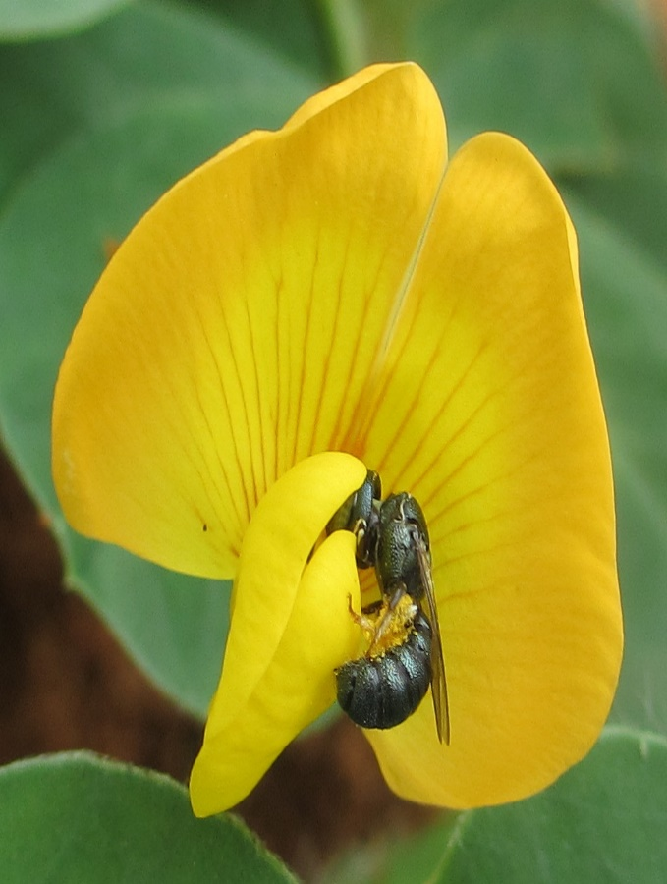
OBJECTIVES
.
To study the nature and extent of genetic variation for seed yield and its related traits in F₂ populations
To estimate the correlation coefficients between seed yield and its related traits in F₂ populations
3. To determine the direct and indirect effects of different characters on seed yield in F₂ populations through path coefficient analysis.

Slide 10
Materials and Methods
Location | Main Oilseeds Research Station, Junagadh Agricultural University, Junagadh
Year and season of experiment | Summer : 29th January, 2016
Treatment details | 12 Parents and 6 Crosses
Design (for evaluation) | Randomized Block Design
Number of replications | Three
Spacing | 60 x 15 cm

Slide 11
List of Parent and Crosses
S. N. | Parental | Cross No. | Cross
P1 | NRCG – C5 – 253 | 1 | NRCG – C5 – 253 x TPG – 41
P2 | TPG – 41
P3 | TG – 71 | 2 | TG – 71 x SB – XI
P4 | SB – XI
P5 | TG – 26 | 3 | TG – 26 x GJG – 22
P6 | GJG – 22
P7 | JB – 1296 | 4 | JB – 1296 x RG – 425
P8 | RG – 425
P9 | GJG – 9 | 5 | GJG – 9 x JUN – 27
P10 | JUN – 27
P11 | CTMG – 9 | 6 | CTMG – 9 x GJG – 22
P12 | GJG – 22

Slide 12
Observations to be recorded
The observations are recorded on randomly selected five plants from each parent and fifty plants from each F₂ per replication. Selected plants are tagged before the emergence of first flower. Data are collected on individual plant basis for eleven characters. The technique/method used for measuring the character is described as below.
1. Days to appearance of first flower: Number of days from the date of sowing to the date of appearance of first flowers in the selected plant in each plot is recorded.
2. Days to maturity: The total number of days is recorded from planting to physiological maturity of selected plants in each plot.

Slide 13
Observations to be recorded
3. Number of primary branches per plant: The primary branches arising on main axis are counted on each selected plant.
4. Plant height (cm): Height is measured in centimeters from ground level to the tip of main axis at maturity.
5. Number of matured pods per plant: Total number of fully developed pods per plant is counted at the time of harvesting.

Slide 14
Observations to be recorded
6. Number of immatured pods per plant: The number of undeveloped pods per plant is counted at the time of harvesting.
7. Kernel yield per plant (g): Kernels removed from fully selected pods is weighed in gram.
8. Shelling outturn (%): The shelling outturn (%) based on the weight of kernels recovered from the pods is calculated as per formula given below.

Slide 15
Observations to be recorded
9. Oil content (%): Representative samples of seed taken at the time of maturity are oven dried for 4 hours at 105°C. About 30g seeds are taken for the analysis of oil content. The oil content in the seed samples is determined by non-destructive method using Nuclear Magnetic Resonance (model oxford 4000 NMR analyzer) as suggested by Tiwari et al. (1974).
10. Protein content (%): The total nitrogen in composite sample of seed is estimated by micro-kjeldal method (Bremmer,1965) and protein content is calculated by multiplying it with a conversion factor, i.e. 5.46.
11. Pod yield per plant (g): The developed dry pods are weighed in grams from each selected plant.

Slide 16
STATISTICAL ANALYSIS
Analysis of variance for experimental design:
The data collected on randomly selected five plants from parents and fifty plants from each F₂ for individual character are averaged and average value is used for statistical analysis according to Panse and Sukhatme (1985).
.

Slide 17
STATISTICAL ANALYSIS
1) Measures of genetic variability:
(a) Heritability (h²) in broad sense: It is calculated according to formula suggested by Allard (1960)
(b) Genotypic coefficient of variation (GCV )
(c) Phenotypic coefficient of variation (PCV )
(d) Genetic advance (GA) : The expected genetic advance under selection is estimated as per the formula described by Allard (1960).
.

Slide 18
STATISTICAL ANALYSIS
2) Correlation coefficients:
In the present study, simple correlation coefficient between the characters are workout as per Al-Jibouri et al. (1958).
3) Path coefficient analysis:
The path coefficient analysis is carried-out as per the method suggested by Dewey and Lu (1959).

Slide 19
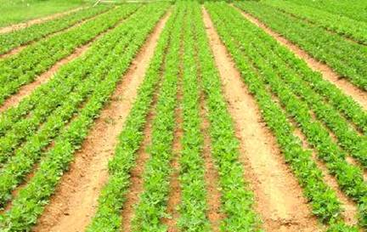
Thanks

