Slide 1

Post graduate thesis presentation
CLINICAL STUDIES ON PREVALENCE AND THERAPEUTIC MANAGEMENT OF CANINE PARVOVIRUS INFECTION IN DOGS
Major Guide
Dr. J. S. Patel
Professor and Head,
Department of Veterinary Medicine
SPEAKER
Pritesh S. Kalavadiya
Reg. no.: 2040416007
Veterinary Clinical Medicine, Ethics and Jurisprudence
Date : 26/09/2018
Minor Guide
Dr. Shivaji H. Talekar
Associate Professor and Hospital Superintendent
Department of T.V.C.C.
,
+--+++
Department of Veterinary Medicine,
College of Veterinary Science and Animal Husbandry,
Junagadh Agricultural University, Junagadh.

Slide 2
CONTENTS
INTRODUCTION
OBJECTIVES
MATERIALS AND METHODS
RESULTS & DISCUSSIONS
CONCLUSIONS
2

Slide 3
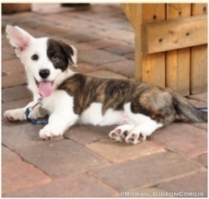

INTRODUCTION
Canine parvovirus (CPV) infection is a highly infectious viral disease of dogs with high morbidity and mortality rates.
Parvo virus infects dogs of all ages however puppies with age between 2 - 6 months are most susceptible for infection .
( Bargujar et al., 2011;
Behera et al., 2015)
3

Slide 4

Cont.
Family
Parvoviridae
Subfamily
Genus
Parvovirinae
Parvovirus
A small, non-enveloped, single-stranded DNA virus.
(International Committee on Taxonomy of Viruses )
4

Slide 5
EMERGENCE OF PARVO VIRUS STRAIN
A new infectious disease of pups, characterized by gastroenteritis or myocarditis was observed worldwide during early 1970s
(Kelly et al., 1979)
A small, round, non-enveloped virus was observed by electron microscopy in stool specimens of affected animals. The virus was named CPV-2
(Burtonboy et al., 1979)
5

Slide 6



Cont.
CPV-2 Variants
CPV-2ab
1984
(Parrish et al., 1985)
CPV-2b
CPV-2c
2000
(Buonavoglia et al., 2001)
6

Slide 7

INCIDENCE
The first prevalence was reported in 1981 at Madras, India by Balu and Thangaraj.
CPV-2 was first time isolated in India in 1982
The incidence of CPV is maximum in winter and
lowest in summer season.
(Ramadas et al., 1982)
(Haque et al., 2012)
7

Slide 8
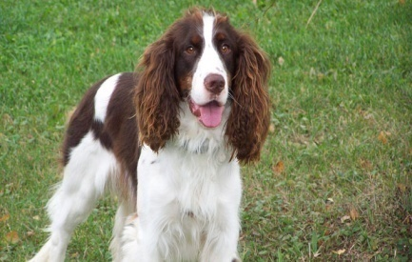
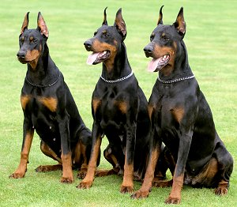
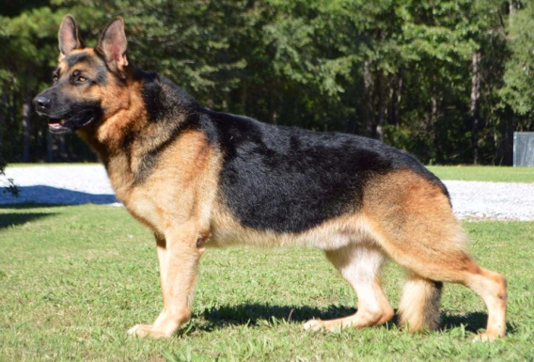
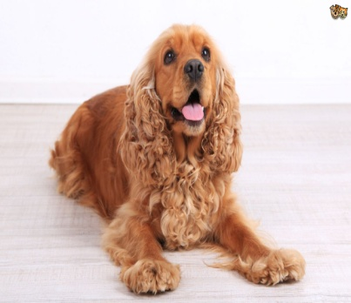
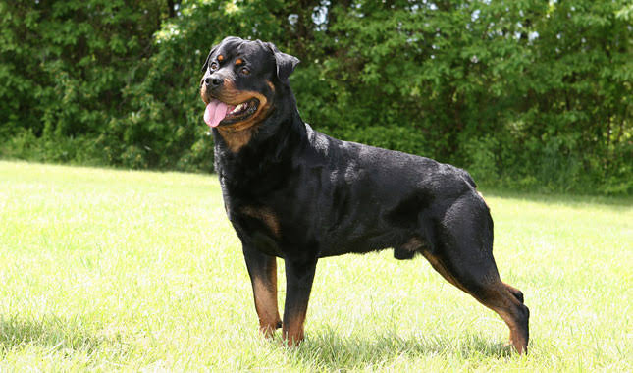
Cont.
All breeds of dogs are susceptible. The crossbreds are less susceptible in comparison to pure breeds like Rottweiler, Doberman pinscher, English springer, Spaniel, German Shepherd and Labrador retriever
(Houston et al., 1996)
8

Slide 9
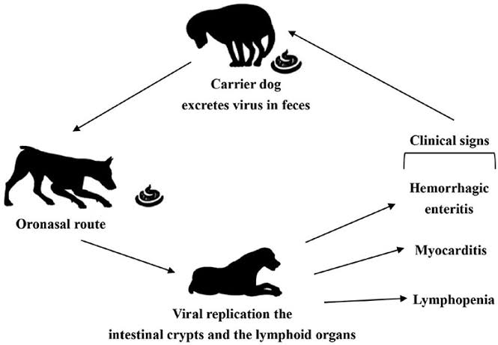
TRANSMISSION
Canine parvovirus spreads through oral and nasal route
Canine parvovirus can remain in faeces-contaminated ground for 5 months or more if conditions are favorable
(Black et al., 1979)
9

Slide 10
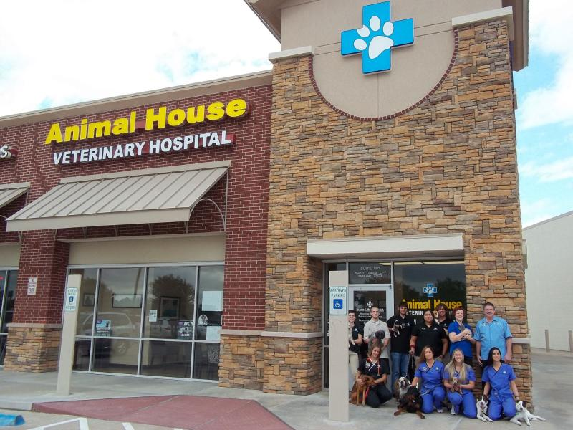
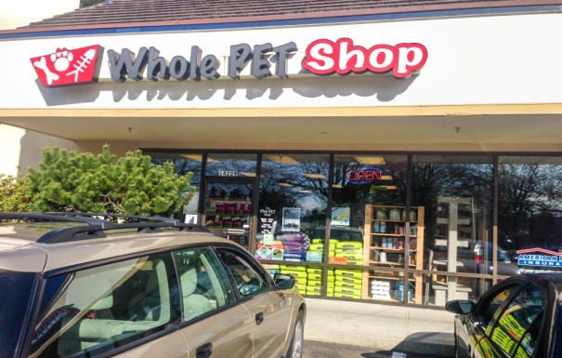
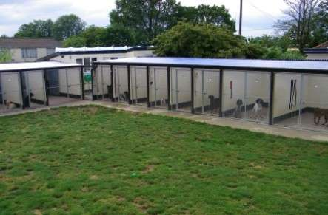
Cont.
The faeces of infected dogs contaminate the places such as Veterinary hospitals, pet shops, boarding kennels and commercial breeding establishments.
These contaminated premises serve as source of secondary infection to the susceptible canine population.
(Jacob et al., 1980)
10

Slide 11
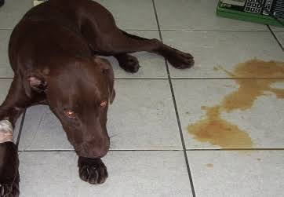
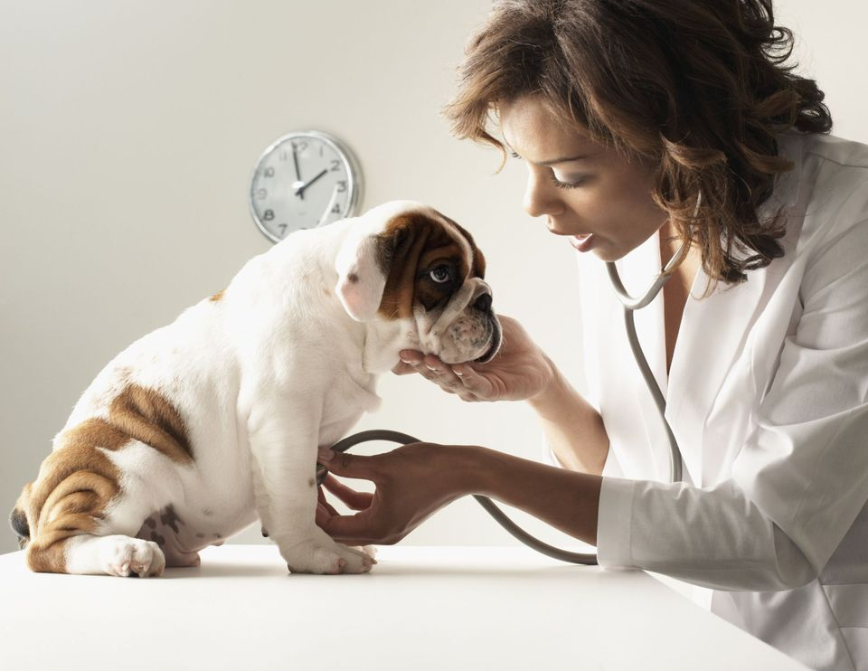
CLINICAL SIGNS
Two form of CPV have been reported.
Enteric Form
Cardiac Form
11

Slide 12


ENTERIC FORM
Depression, loss of appetite, vomiting, high fever and severe foul smelling diarrhoea are most common signs
12

Slide 13
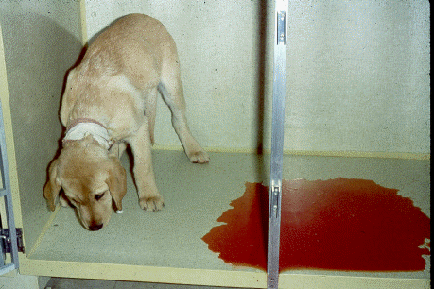
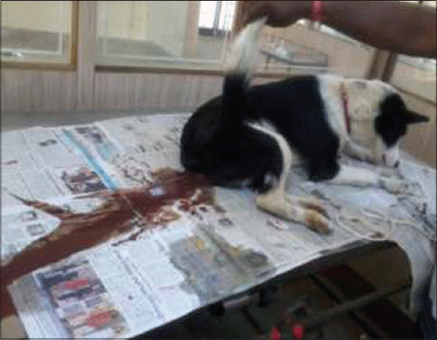
Cont.
Hyperthermia is observed in the initial stage of the disease but gradually turns into hypothermia with advancement of vomiting and diarrhoea
Faeces may be watery, yellow in color or tinged with blood in severe cases
(Kramar et al., 1980)
13

Slide 14
CARDIAC FORM
Puppies below 3 months age are prone to cardiac form.
In cardiac form, 70% pups will die due to heart failure and the remaining 30% will have pathological changes which may result in death after many months or even years later
(Appeal et al., 1979)
(Mochizuki et al., 1996)
14

Slide 15
Cont.
Pups which may collapse, have cold extremities, pale mucosa and show gasping respiration or terminal convulsions
In cardiac form, diarrhoea may or may not be present
(Carpenter et al., 1980)
(Hayes et al., 1979)
15

Slide 16
OBJECTIVES
To study the prevalence of canine parvovirus infections
To study clinical and haematological changes in canine parvovirus infected dogs
To study the efficacy of diagnosis using different methods
To study the therapeutic regimen in infected dogs
16

Slide 17

MATERIALS AND METHODS
Location
Department of Veterinary Medicine ,
College of Veterinary Science and Animal Husbandry, J.A.U.
Duration of experiment : September, 2017 to June, 2018
17

Slide 18
  SCREENING
  Screening was carried out of total 100 dogs of different age, sex, breed suspected for CPV presented at T.V.C.C., College of Veterinary Science and A. H., Junagadh
  The primary screening of suspected cases was performed by using Scan Vet Parvo Kit, a rapid immunochromatography based test
18

Slide 19
    OBSERVATIONS RECORDED
Case details (Breed, Age, Sex,)
Vaccination status
Rectal Temperature
Heart Rate
Respiration rate
19

Slide 20
SAMPLE COLLECTION
FAECES
BLOOD
Sterile swab
HEMATOLOGY
Scan Vet Parvo kit
Polymerase Chain Reaction (PCR)
20

Slide 21
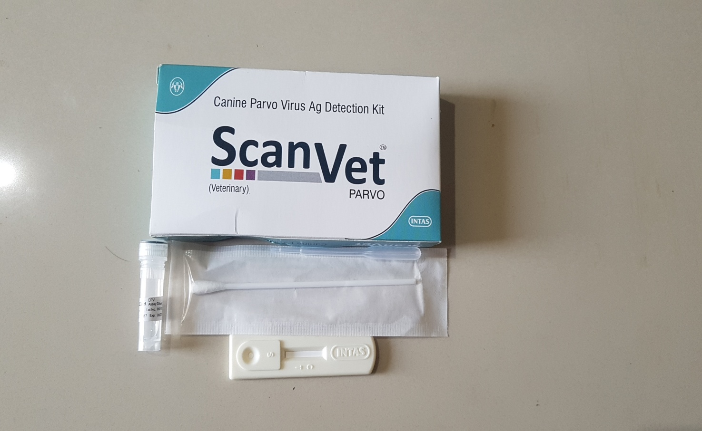
DIAGNOSTIC KIT
21

Slide 22
    HAEMETOLOGICAL PARAMETERS
HAEMOGLOBIN (g/dL)
MEAN CORPUSCULAR VOLUME (fl)
TOTAL ERYTHROCYTE COUNT
(x10⁶ / µl)
MEAN CORPUSCULAR HAEOGLOBIN (pg)
PACKED CELL VOLUME (%)
DLC (%)
TOTAL LEUCOCYTE COUNT
(x 10³ / µl)
PLATELETS COUNTS (x 10⁵ /µl)
MEAN CORPUSCULAR HAEOGLOBIN CONCENTRATION (g/dL)
22

Slide 23
THERAPEUTIC TRIAL
Groups | No. of animals | Treatments
GROUP A | 6 | Inj. Cefotaxime @ 25 mg/kg bwt q 24 hr intravenous (IV) along with supportive drugs
GROUP B | 6 | Inj. Amikacine @ 10 mg/kg bwt q 24 hr intramuscular (IM) and Ceftriaxone @ 25 mg/kg bwt q 24 hr intravenous (IV)along with supportive drugs
GROUP C | 6 | Inj. Ceftriaxone Tazobectum @ 25 mg/kg bwt q 24 hr intravenous (IV) along with supportive drugs
23

Slide 24
SUPPORTIVE DRUGS
Antacids | Pantoprazole @ 1mg/kg bwt q 24 hr intravenous (IV)
Antiemetics | Ondenseterone @ 0.5 mg/kg bwt q 24 hr intravenous (IV)
Fluid therapy | Replacement fluid /24 hrs as per % of Dehydration*, DNS, NS and RL
Supportive drugs | Syrup Sucralfate @ 1g 1 q 8 hr per oral (PO), Metronidazole @ 15 mg/kg bwt q 24 hr intravenous (IV)
24

Slide 25
Statistical analysis
The data obtained during the study were statistically analyzed using IBM SPSS (version 20.0) software
The hematological parameters in research work were sorted accordingly to the groups and analyzed using one way analysis of variance (ANOVA) for within group comparison on 0th day and 5th day with healthy control animals, variant means were compared using ‘Duncan New Multiple Range Test’ (DMRT).
All the data obtained were presented in Mean ± SE values
25

Slide 26
RESULTS AND DISCUSSION
In the present study, total 100 fecal samples from dogs showing the symptoms like vomiting, diarrhoea, melena, dehydration and anorexia were screened by ScanVet Parvo Kit and Polymerase Chain Reaction.
The prevalence in relation to breed, age, sex, vaccination status and month were studied based on the result of PCR assay.
The hematological alterations in the positive cases of CPV were studied on 0th day and 5th day.
26

Slide 27
Table 1: Comparison of clinical parameters
Parameters | Healthy dogs | CPV affected dogs
Body Temperature (ºF) | 101.5 ± 0.05 | 99.9 ± 0.09**
Heart rate (per min) | 91.07 ± 1.05 | 57.68 ± 1.60 **
Respiration rate (per min) | 29.23 ± 0.72 | 31.66 ± 0.76*
27

Slide 28
Table 2: Temperature
Rectal temperature | Number of cases | Percentage
Fever (above 102.5°F) | 05 | 5 %
Normal temperature (100 – 102.5°F) | 26 | 26 %
Hypothermia (below 99°F) | 69 | 69 %
Total | 100 | 100 %
28

Slide 29
Figure 1: Temperature status of CPV infected dogs
29

Slide 30
Table 3: Diarrhoea
Type of faeces | Number of cases | Percentage
Greenish | 23 | 23 %
Yellowish | 28 | 28 %
Haemorrhagic | 49 | 49 %
Total | 100 | 100 %
30

Slide 31
Figure 2: Types of diarrhoea in CPV infected dogs
31

Slide 32
Table 4: Vomiting
Vomiting | Number of cases | Percentage
Present | 92 | 92 %
Absent | 08 | 08 %
Total | 100 | 100 %
32

Slide 33
Figure 3: Vomition status of CPV infected dogs
33

Slide 34
Table 5: Prevalence
Test | Fecal samples | Positive | Prevalence (%)
ScanVet Parvo | 100 | 26 | 26
PCR | 100 | 40 | 40
34

Slide 35
Figure 4: Percentage of positive cases of CPV infection
35

Slide 36
Table 6: Breed wise prevalence
Breed | Positive by PCR | Prevalence (%)
Non-Descript (n=46) | 13 | 32.50
Exotic (n= 54) | 27 | 67.50
Total | 40 | -
36

Slide 37
Figure 5: Breed wise prevalence of CPV infection
37

Slide 38
Table 7: Individual breed wise prevalence
Breed | No. of fecal samples | Positive by PCR | Prevalence (%)
Labrador retriever | 10 | 4 | 10
Rottweiler | 08 | 4 | 10
Pomeranian Spitz | 04 | 02 | 05
GSD | 21 | 12 | 30
Doberman Pinscher | 7 | 4 | 10
Great Dane | 1 | 0 | 0
Saint Bernard | 1 | 0 | 0
Siberian Husky | 2 | 1 | 2.5
Non- descript | 46 | 13 | 32.5
Total | 100 | 40 | -
38

Slide 39
Figure 6: Individual breeds wise prevalence of CPV infection
39

Slide 40
Table 8: Age wise prevalence
Age (Months) | No. samples | Positive for PCR | Prevalence (%)
0 – 2 | 20 | 12 | 30
2 – 4 | 43 | 17 | 42.5
4 – 6 | 22 | 07 | 17.5
6 – 8 | 11 | 04 | 10
Above 8 | 04 | 00 | ---
Total | 100 | 40 | ---
40

Slide 41
Figure 7: Age wise prevalence of CPV infection
41

Slide 42
Table 9: Sex wise prevalence
Sex | No. of Sample | Positive by PCR | Prevalence (%)
Male | 66 | 22 | 55
Female | 34 | 18 | 45
Total | 100 | 40 | -----
42

Slide 43
Figure 8: Sex wise prevalence of CPV infection
43

Slide 44
Table 10: Month wise prevalence
Months | No. of Sample | Positive by PCR | Prevalence (%)
January | 11 | 04 | 10
February | 14 | 04 | 10
March | 08 | 0 | 0
April | 12 | 1 | 2.5
May | 01 | 0 | 0
June | 00 | 0 | 0
September | 02 | 0 | 0
October | 16 | 07 | 17.5
November | 22 | 14 | 35
December | 14 | 10 | 25
44

Slide 45
Figure 9: Month wise prevalence
45

Slide 46
Table 11: Vaccination status wise prevalence
Status | No. of sample | Positive by PCR | Prevalence (%)
Non Vaccinated | 92 | 38 | 95
Vaccinated | 08 | 2 | 5
Total | 100 | 40 | -
46

Slide 47
Figure 10: Vaccination status wise prevalence of CPV infection
47

Slide 48
Table 12: Mean Hemoglobin (g/dL) value of CPV
affected dogs
GROUP | 0th day | 5th day
A | 10.00ª ± 0.82_{X} | 10.35^{A} ± 1.13_{Y}
B | 8.88ª ± 0.38x | 13.18^{B} ± 1.28_{Y}
C | 10.22ª ± 0.65x | 9.80^{A} ± 0.80_{Y}
Control | 12.76^{b} ± 0.37 | 13.78^{B} ± 0.32
Note: Values with different superscript indicate significant difference between the groups. Values with different subscript indicate significant difference within the group.
48

Slide 49
Figure 11: Mean Haemoglobin (g/dL) values of group A, group B and group C
on 0th day and 5th day
49

Slide 50
Table 13: Mean Packed cell volume (%) values
of CPV affected dogs
GROUP | 0th day | 5th day
A | 32.70ª ± 1.41x | 31.86^{A} ± 1.77_{Y}
B | 33.98ª ± 2.27x | 25.70^{B} ± 2.46x
C | 33.85ª ± 1.02x | 30.10^{A} ± 1.41_{Y}
Control | 25.10^{b} ± 0.79 | 28.10^{B} ± 1.15
Note – Values with different superscript indicate significant difference between the groups. Values with different subscript indicate significant difference within the group
50

Slide 51
Figure 12: Mean Packed cell volume (%) values of group A, group B and
group C on 0th day and 5th day
51

Slide 52
Table 14: Total Erythrocyte count (x 10⁶ / µl)
mean value of CPV affected dogs
GROUP | 0th day | 5th day
A | 4.11ª ± 0.36 _{X} | 4.15 ^{A} ± 0.22 _{X}
B | 3.49 ª ± 0.32 _{X} | 5.84 ^{B} ± 0.21 _{Y}
C | 3.57 ª ± 0.49_{X} | 4.56 ^{A} ± 0.84 _{Y}
Control | 5.64 ^{b} ± 0.20 | 6.44^{B} ± 0.28
Note – Values with different superscript indicate significant difference between the groups. Values with different subscript indicate significant difference within the group
52

Slide 53
Figure 13: Mean Total erythrocyte counts (x 10⁶ / µl) values of group A, group B
and group C on 0th day and 5th day
53

Slide 54
Table 15: Mean Total Leukocyte count (/ µl)
values of CPV affected dogs
GROUP | 0th day | 5th day
A | 4974.33ª ± 890.23 _{X} | 6268.70 ^{A} ± 468.21 _{Y}
B | 5052.33 ª ± 1040.78 _{X} | 9536.67 ^{B} ± 734.04 _{Y}
C | 3732.50 ª ± 304.66 _{X} | 4120.80 ^{A} ± 234.89 _{Y}
Control | 10010.33^{b} ± 524.48 | 12000.45^{B} ± 574.28
Note – Values with different superscript indicate significant difference between the groups. Values with different subscript indicate significant difference within the group
54

Slide 55
Figure 14: Mean Total leukocyte counts (/ µl) values of group A, group B
and group C on 0th day and 5th day
55

Slide 56
Table 16: Mean Neutrophils (%) values of CPV
affected dogs
GROUP | 0th day | 5th day
A | 71.83 ª ± 3.36 _{X} | 71.80 ^{A} ± 2.49 _{X}
B | 71.17 ª ± 2.12 _{X} | 58.66^{B} ± 2.04 _{Y}
C | 78.33 ª ± 3.62 _{X} | 71.50 ^{A} ± 3.30 _{Y}
Control | 58.50^{b} ± 1.76 | 68.30^{B} ± 1.56
Note – Values with different superscript indicate significant difference between the groups. Values with different subscript indicate significant difference within the group
56

Slide 57
Figure 15: Mean Neutrophils (%) values of group A, group B and group C on 0th day and 5th day
57

Slide 58
Table 17: Mean Lymphocyte (%) value of CPV
affected dogs
GROUP | 0th day | 5th day
A | 21.33 ª ± 1.89 _{X} | 24.16 ^{A} ± 1.35 _{Y}
B | 23.00 ª ± 1.48 _{X} | 30.00^{B} ± 0.93 _{Y}
C | 23.66 ª ± 1.52 _{X} | 24.66 ^{A} ± 1.30 _{Y}
Control | 30.00^{b} ± 1.52 | 29.00^{B} ± 1.22
Note – Values with different superscript indicate significant difference between the groups. Values with different subscript indicate significant difference within the group
58

Slide 59
Figure 16: Mean lymphocytes (%) values of group A, group B and group C on 0th day and 5th day
59

Slide 60
Table 17: Mean Monocyte (%) value of CPV
affected dogs
GROUP | 0th day | 5th day
A | 5.67 ^{b} ± 0.56_{X} | 4.66 ^{A} ± 0.80 _{Y}
B | 5.33 ^{b} ± 1.14 _{X} | 2.16^{B} ± 0.30 _{Y}
C | 7.83 ^{c} ± 0.79 _{X} | 5.00 ^{A} ± 1.15 _{Y}
Control | 2.66ª ± 0.21 | 3.66^{B} ± 0.22
Note – Values with different superscript indicate significant difference between the groups. Values with different subscript indicate significant difference within the group
60

Slide 61
Figure 17: Mean Monocyte (%) values of group A, group B and group C on 0th day and 5th day
61

Slide 62
Table 18: Mean Eosinophils (%) value of CPV
affected dogs
GROUP | 0th day | 5th day
A | 1.00 ª ± 0.36 _{X} | 1.50 ^{A} ± 0.40 _{Y}
B | 0.83 ª ± 0.31 _{X} | 1.33 ^{A} ± 0.33 _{Y}
C | 0.83 ª ± 0.30 _{X} | 1.33 ^{A} ± 0.49 _{Y}
Control | 1.66 ª ± 0.20 | 1.78^{A} ± 0.25
Note – Values with same superscript indicate non significant difference between the groups. Values with different subscript indicate significant difference within the group
62
62

Slide 63
Figure 18: Mean Eosinophil (%) values of group A, group B and group C on 0th day and 5th day
63

Slide 64
Table 19: Mean Platelets (x 10³ /µl) value of
CPV affected dogs
GROUP | 0th day | 5th day
A | 284.50 ª ± 32.37_{x} | 304.06 ^{A} ± 30.93 _{X}
B | 299.17 ª ± 29.35_{X} | 351.00 ^{A} ± 0.20 _{X}
C | 284.50 ª ± 32.37 _{X} | 280.50 ^{A} ± 29.81 _{X}
Control | 287.33 ª ± 23.76 | 299.33^{A} ± 22.77
Note – Values with same superscript indicate non significant difference between the groups. Values with different subscript indicate significant difference within the group
64
64

Slide 65
Figure 19: Mean platelets (x 10³ / µl) values of group A, group B and group C on 0th day and 5th day
65

Slide 66
Table 20: Mean MCV (fl) value of CPV affected
dogs
GROUP | 0th day | 5th day
A | 76.43 ª ± 5.20 _{X} | 79.68 ^{A} ± 2.35 _{X}
B | 81.88 ª ± 2.32 _{X} | 68.60 ^{B} ± 4.02 _{Y}
C | 81.80 ª ± 1.83 _{X} | 79.77 ^{A} ± 3.59 _{X}
Control | 62.50 ^{b} ± 2.37 | 65.54 ^{B} ± 1.37
Note – Values with different superscript indicate non significant difference between the groups. Values with different subscript indicate significant difference within the group
66
66
66

Slide 67
Figure 20: Mean MCV (fl) values of group A, group B and group C on 0th day and 5th day
67

Slide 68
Table 21: Mean MCH (pg) value of CPV
affected dogs
GROUP | 0th day | 5th day
A | 14.01ª ± 0.50 _{X} | 14.55 ^{A} ± 0.43 _{X}
B | 16.47 ª ± 0.83 _{X} | 20.72 ^{B} ± 0.74 _{Y}
C | 15.97 ª ± 0.48 _{X} | 16.00 ^{A} ± 0.49 _{X}
Control | 22.13 ^{b} ± 0.83 | 25.12 ^{B} ± 0.73
Note – Values with different superscript indicate non significant difference between the groups. Values with different subscript indicate significant difference within the group
68
68
68

Slide 69
Figure 21: Mean MCH (pg) values of group A, group B and group C on 0th day and 5th day
69

Slide 70
Table 22: Mean MCHC (g/dl) value of CPV
affected dogs
GROUP | 0th day | 5th day
A | 27.27 ª ± 0.36 _{X} | 27.2 ^{A} ± 0.69 _{X}
B | 26.63 ª ± 0.71 _{X} | 32.68 ^{B}± 0.59 _{Y}
C | 27.10 ª ± 0.98 _{X} | 27.30 ^{A} ± 0.77 _{X}
Control | 31.62 ^{b} ± 0.60 | 33.60^{B} ± 0.66
Note – Values with different superscript indicate non significant difference between the groups. Values with different subscript indicate significant difference within the group
70
70
70

Slide 71
Figure 21: Mean MCHC (g/dL) values of group A, group B and group C on 0th day and
5th day
71

Slide 72
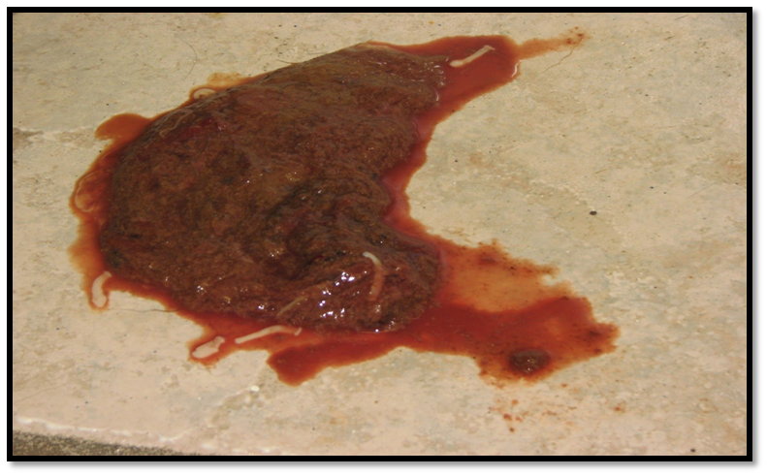
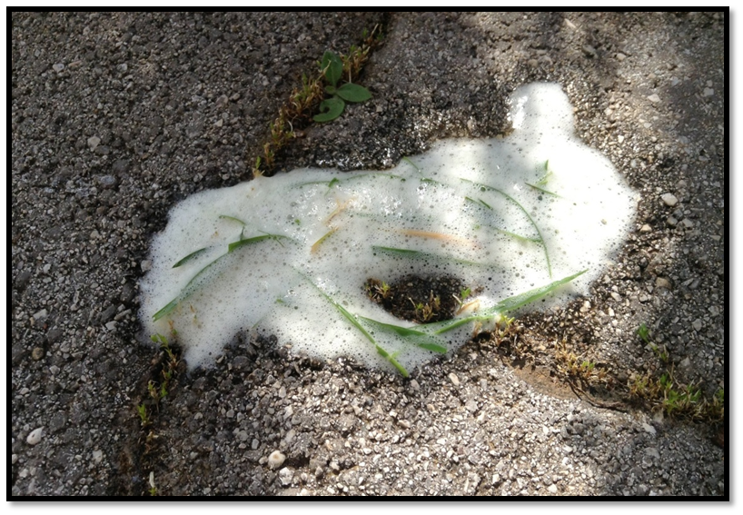
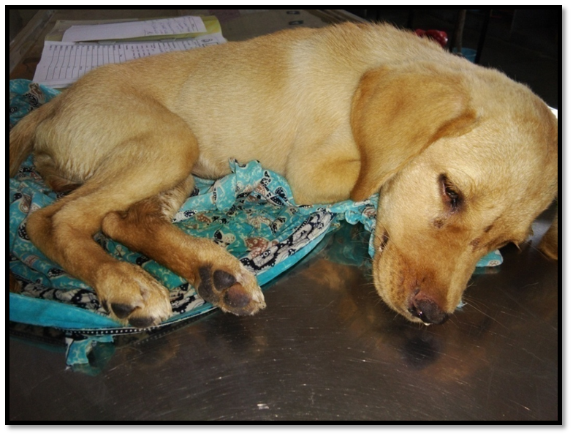
A. Haemorrhagic diarrhoe in 2 month old Rottweiler pup
B. Frothy vomiting in 3 month old Doberman pup
72
C. Lethargic condition of 2 month old Labrador pup on day 0

Slide 73
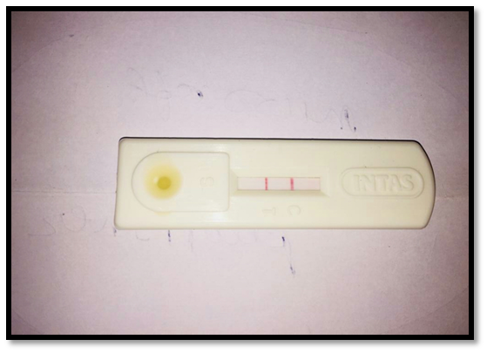
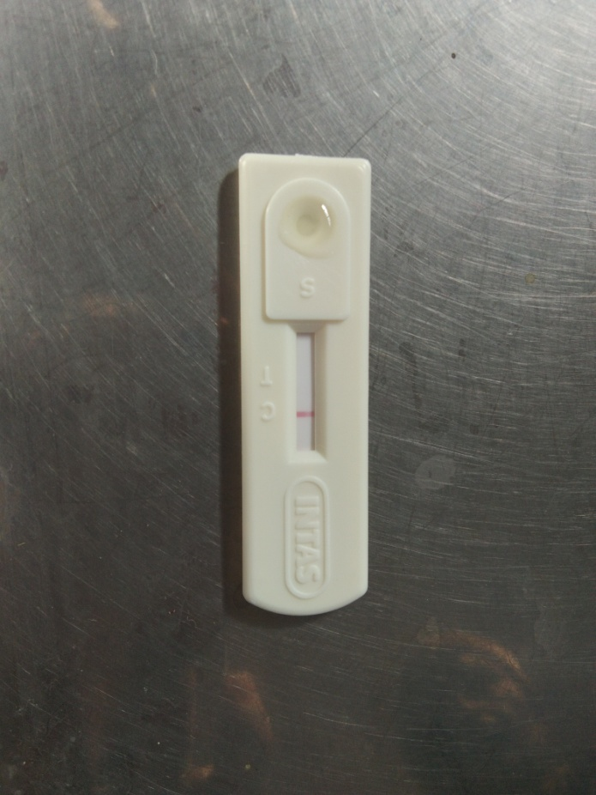
RESULT IN SCANVET PARVO KIT
NEGATIVE
POSITIVE
73

Slide 74
Sensitivity and Specificity of ScanVet Parvo kit
Test |  | PCR (Standard test)
 | Test result | Positive | negative | Total
ScanVet Parvo kit | Positive | 26 | 0 | 26
 | Negative | 14 | 60 | 74
 | Total | 40 | 60 | 100
 | PCR (Standard test)
ScanVet Parvo kit | Sensitivity | 65 %
 | Specificity | 100 %
74

Slide 75
RESULTS OF PCR ASSAY
No. of positive samples | Band size | Parvovirus strain
37 | 583 bps | 2c
3 | 681 bps | 2ab
Total = 40 | -- | ---
75

Slide 76
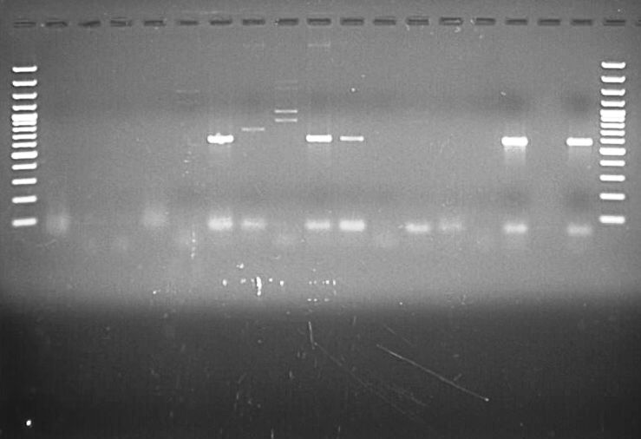
DETECTION OF CPV BY PCR
1 2 3 4 5 6 7 8 9 10 11 12 13 14 15 16 17 18 19
Well 1 & well 19 - 100bp Plus DNA
marker
Well 7 - CPV 2ab strain (681 bp) Well 10 - CPV 2ab strain (681 bp) Well 11 - CPV 2ab strain (681 bp) Well 16 - CPV 2c strain (583 bp) Well 18 - Positive control (583 bp)
3000 bp
2ab
1000 bp
500 bp
2ab
2ab
2c
100 bp
76

Slide 77
CLINICAL EFFICACY
Group | No. of died animal | Case fatality rate | Clinical efficacy
A (n = 6) Inj. Cefotaxime @ 25 mg/kg | 3 | 50 % | 50 %
B (n = 6) Inj. Amikacine @ 10 mg/kg and Inj. Ceftriaxone @ 25 mg/kg | 0 | 0 % | 100 %
C (n = 6) Inj. Ceftriaxone Tazobectum @ 25 mg/kg | 2 | 33.33 % | 66.66 %
77

Slide 78
CONCLUSIONS
The overall prevalence of canine parvovirus infection at was 40 % in diarrheic dog at T.V.C.C., College of Veterinary Science and Animal Husbandry, JAU, Junagadh
The higher prevalence of Canine parvovirus was observed in exotic breeds. Higher prevalence observed in German shepherd and lower prevalence were found in Pomeranian spitz and Siberian husky
78

Slide 79
Cont..
Higher prevalence of CPV infection was noted in the month of November followed by October, February, January The lower prevalence was noted in the month of April
The prevalence of CPV infection was higher in male than female
Dogs in the age group of 2 - 4 months were more prone to CPV followed by 0 - 2 months, 4 - 6 months and 6 - 8 months age groups
79

Slide 80
Cont..
In the CPV affected dogs, hemoglobin (g/dL), lymphocyte (%), total leukocyte count (µl), total erythrocyte counts(10⁶ / µl), MCH (pg), MCHC (g/dl) were lower and packed cell volume (%), neutrophils (%), MCV (fl) and monocytes (%) count were found higher
The sensitivity and specificity of ScanVet Parvo kit were 65 % and 100 %, respectively in comparison to PCR technique.
The clinical efficacy of Ceftriaxone along with Amikacin was greater in CPV affected dogs in terms of survivability and recovery
80

Slide 81

THANK YOU

