Slide 1
Prospects and problems of exoTic species aquaculture
Sweety Singh
ID No. U-18-TN-03-002-M-F-005
II M.F.Sc.
DAQ

Slide 2
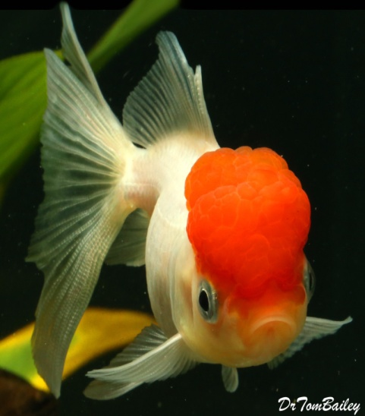
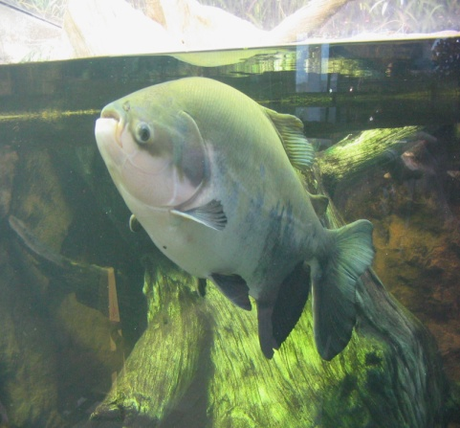
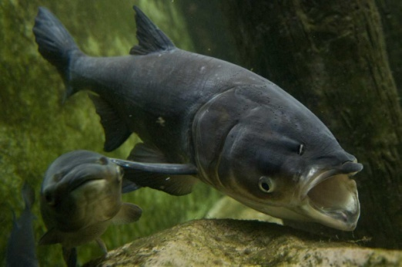
EXOTIC SPECIES
Alien or exotic aquatic organisms- non-native plants, animals and fishes- introduced- new habitats where they do not belong- worldwide agents of habitat alteration and degradation (Bhat et al., 2014).
A major cause for biological diversity throughout the world is considered as “biological pollutants.”
Exotic fishes - non-indigenous- having their origin in another country- has been introduced into the Indian waters.
Gold fish
Pacu
Bighead carp

Slide 3
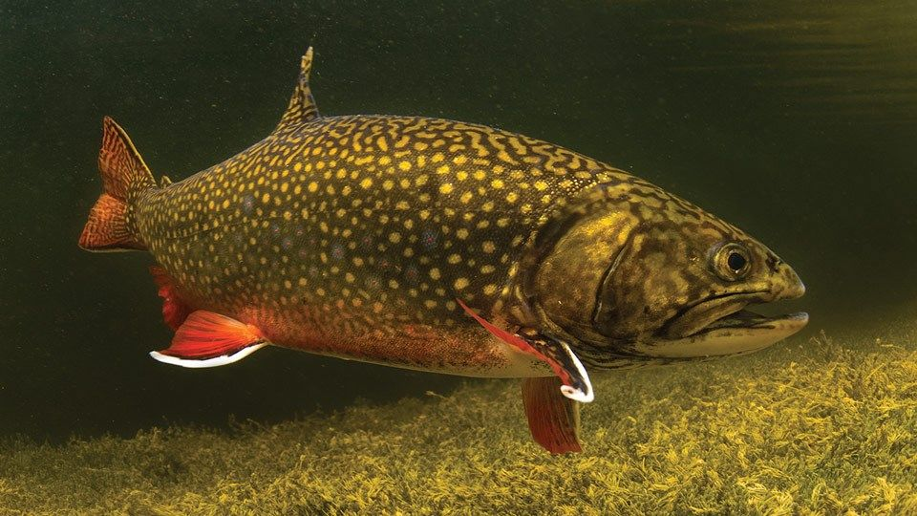
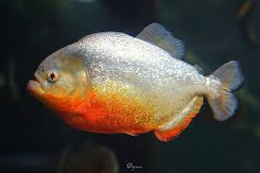
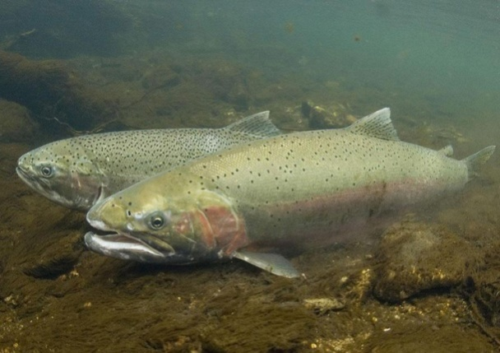
They - established culture technologies and the economics of production and marketability.
Brought- India- intentionally or otherwise for the purposes of aquaculture, aquarium trade, therapeutic value, research and biological control.
Many such species- tilapia, common crap, Chinese carp, rainbow trout, Japanese and European oysters, etc.
Brok trout
Red piranha
Steelhead trout

Slide 4
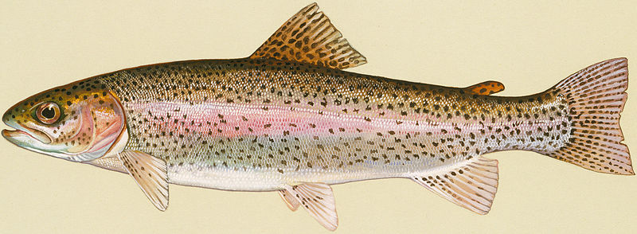
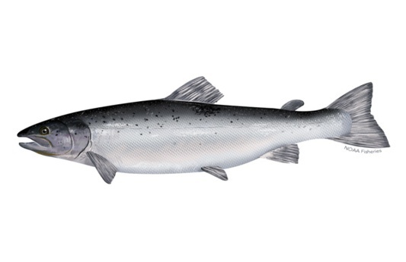
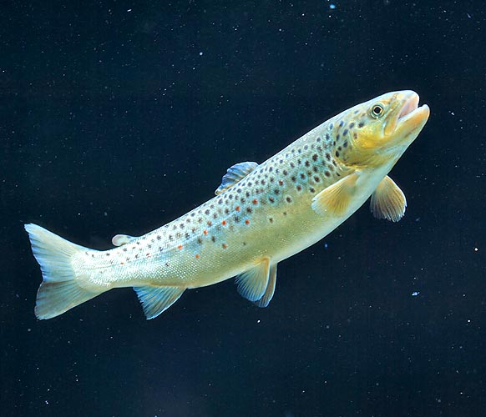
Global fish production- peaked- 171 million tonnes- 2016,-aquaculture- 47 %- total and 53 %- if fishes of non-food uses are excluded.
The contributions are made not only by the endemic species but also by exotic species.
To augment ﬁsh production, a number of exotic ﬁshes have been introduced for aquaculture purposes throughout the world
Rainbow trout
Atlantic salmon
Brown trout

Slide 5
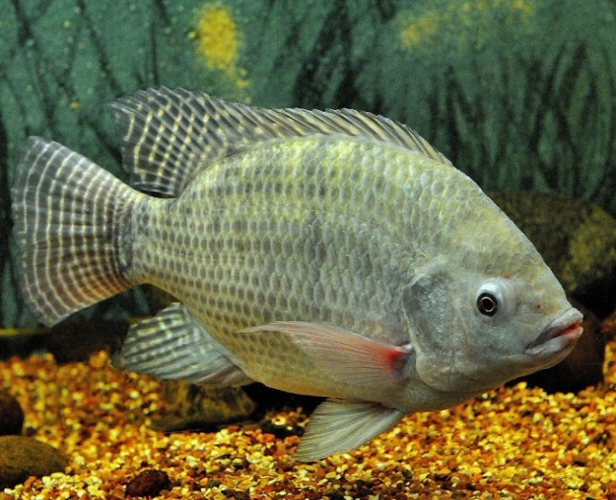
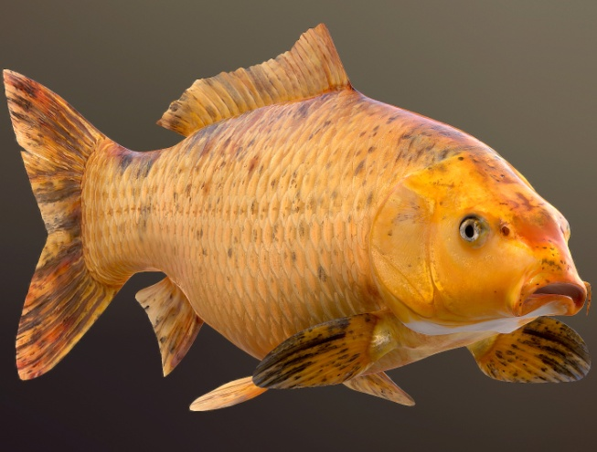
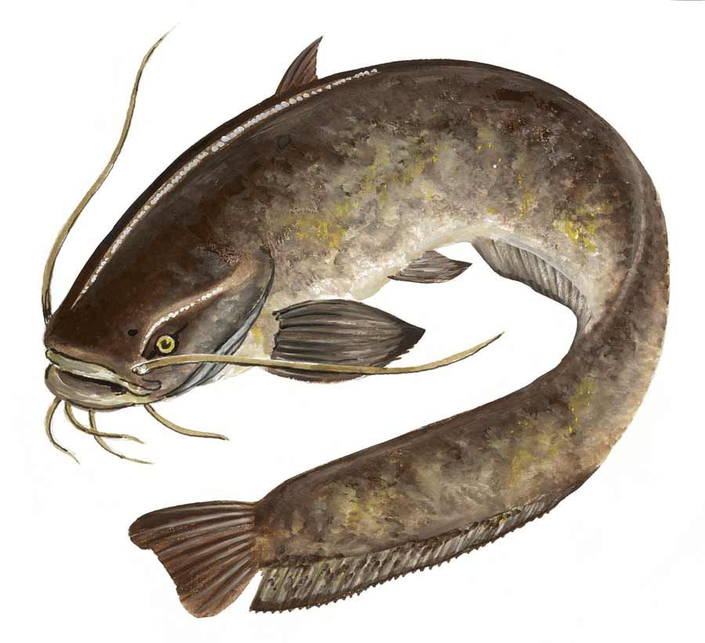
During 2000 to 2004, - exotic freshwater ﬁnﬁshes- 3.6 million tonnes or 16% of the global aquaculture production (De Silva et al. 2009).
Over the past decade- exotic ﬁnﬁsh species -over 12.2% of total cultured ﬁnﬁsh production and the proportion is as much as 35% when China is excluded (De Silva et al. 2006, 2009).
India- rich aquatic biodiversity- 2319 ﬁnﬁsh species, which includes 838 freshwater, 113 brackish water and 1368 marine ﬁshes
In India- over 300 exotic fish species- including 291 ornamental species, 31 aquaculture species and 3 larvicidal fishes are recorded (Lakra et al., 2008; Garcia-Berthou et al., 2005, Garcia Berthou 2007; DeSilva et al., 2009; Singh and Lakra, 2011).
Tilapia
Golden carp
African catfish

Slide 6
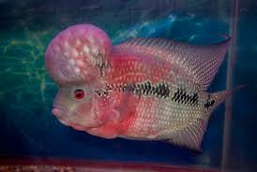
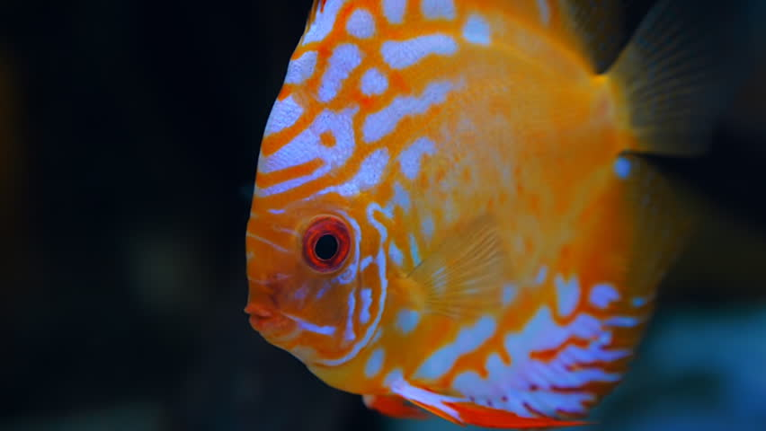
India- ornamental fish trade- dominated - over 500 exotic fish variety.
Over one billion ornamental ﬁsh comprising more than 4000 freshwater and 1400 marine species are traded internationally each year, making it one of the most important components of the global ﬁsh trade of which exotic species contribute a major share.
In India, hundreds of exotic ornamental species form part of the aquarium trade.
Flower horn
Discuss

Slide 7
Table: Details of species introduced
Fish species | Year of introduction | Home country
A. Game fishes 1. Brown trout (Salmo trutta fario) | 1863­1900 | U.K.
2. Loch Leven Trout (Salmo levensis) | 1863 | U.K.
3. Rainbow Trout (Salmo garirdnen) | 1907 | Sri Lanka & Germany
4. Eastern Brook Trout (Salvelinus fontinalis) | 1911 | U.K.
5. Sockeye salmon (Oncorhynchus nerka) | 1968 | Japan
6. Atlantic Salmon (Salmo salar) | 1968 | U.S.A.
B. Food Fishes 1. Golden Carp (Carassiuscarassius ) | 1870 | U.K.
2. Tench (Tincatinca) | 1870 | U.K.
3. Gourami (Osphronemusgoramy) | 1916 | Java & Mauritius
4. Common Carp (Cyprinus carpio) German strain | 1939 | Sri Lanka
5. Tilapia (Oreochromis mossambicus) | 1952 | Africa
6. Common Carp (Cyprinus carpio) Bangkok strain | 1957 | Thailand
7. Grass Carp (Ctenopahryngodonidella) | 1957 | Japan
8. Silver Carp (Hypophthalmichthys molitrix) | 1959 | Hong Kong
9. Tawes (Puntius javanicus) | 1972 | Indonesia
10. Sutchi (Pangasianodonhypophthalmus) | 1997 | Vietnam
11. Whiteleg shrimp (Litopenaeusvannamei) | 2010 | USA

Slide 8
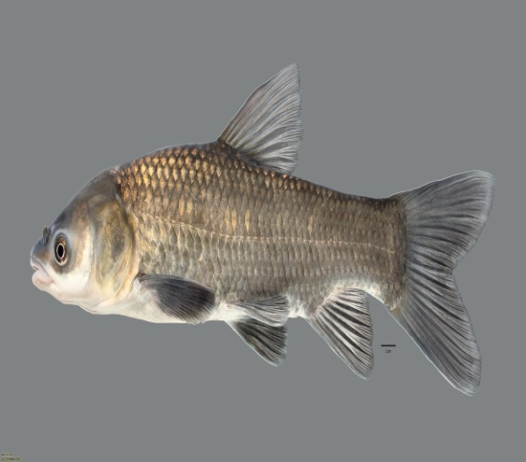
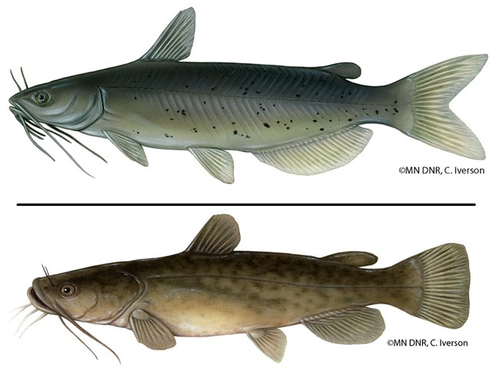

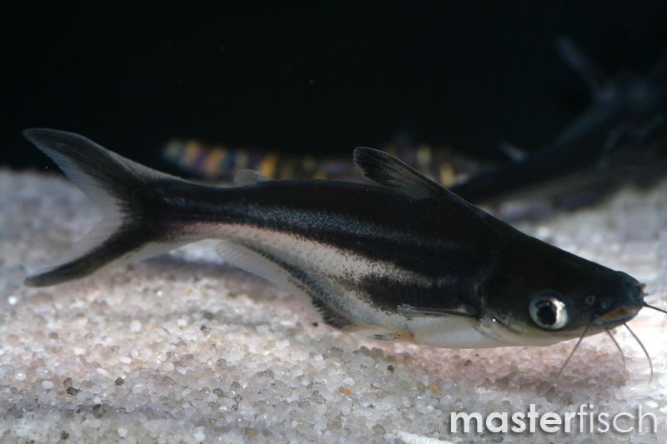
C. Larvicidal Fishes 1. Guppy (Poecilia reticulata) | 1908 | South America
2. Top Minnow (Gambusia affinis) | 1928 | Italy
D. Ornamental Fishes 1. Live bearers (27 species) |  | From various countries
2. Eggs layers (261 species) E. Unauthorised introduction Bighead carp (Aristichtisthis nobilis) African Catfish (Clarias gariepinus) Nile Tilapia (Oreochromis niloticus) Red Tilapia (Oreochromis sp.) Red Piranha (Serrasalmus natteren) |  | From various countries
Channel catfish
Black carp
Pangas

Slide 9
SELECTION OF EXOTIC SPECIES
Should grow fast.
Should fulfill the need because of the absence of a similar desirable species in the locality.
Should be compatible and should not compete
Should not undergo cross-breeding with native species
Should be devoid of pests, parasites or diseases,
Should live and reproduce in equilibrium with the new environment
Should not cause any adverse ecological effects.
Should be hardy, easy to handle and have other usefulness
Should have proven technologies of culture and good economic viability.

Slide 10
(After FAO/DIAS 2005-­2013)

Slide 11
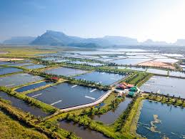
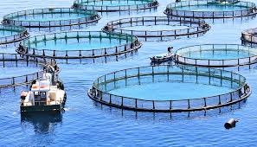
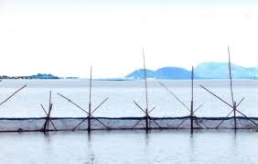
PURPOSE OF INTRODUCTION
AQUACULTURE
Attracts- highest introduction- compared to other purposes- demand for a particular species and trade in the global market.
Exotic species- important and significant- development of aquaculture and trade- aquaculture products.
As a result of this trend, only 9 species accounted for 78% of the total world freshwater fish culture in 1996.
These major species for fish culture have been introduced into countries throughout the world.
Current trends point to an increasing number of crustacean species, which are being introduced worldwide for the rapidly expanding brackish water shrimp culture.
Introduction- pacific white shrimp species- Asian region -important contributors -spectacular growth of aquaculture in the region- recent times.

Slide 12
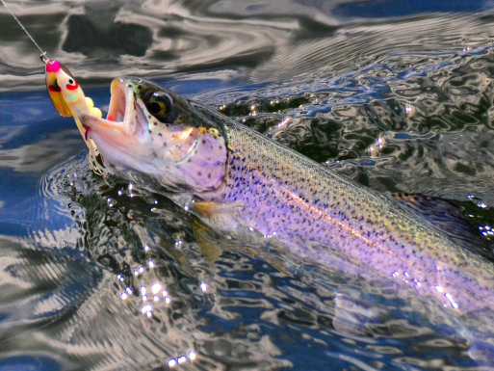
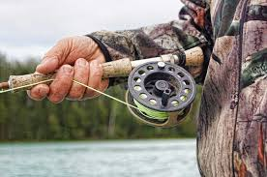
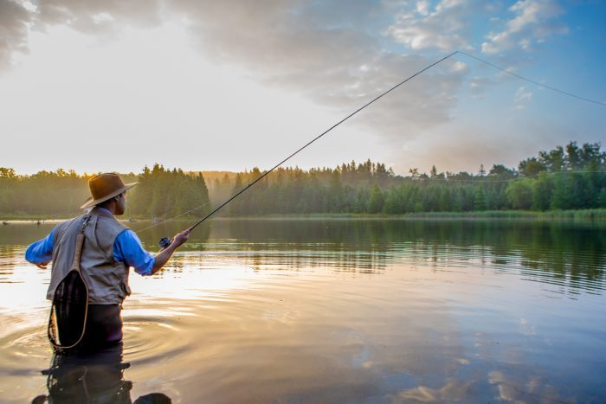
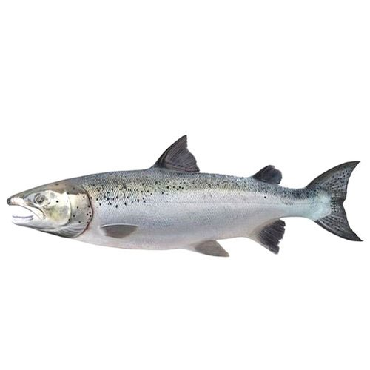


SPORT FISHING
Sport fishing - second major motive for introduction.
1988- All over the world- 78 species were recorded as having been introduced for sport purposes.
More than 200 species- transplanted- stocked in public and private waters for sport fishing in North America (Bensen, 2000).
A great number of these are salmonids or larger predators having the fighting qualities sought by sport fishermen.
In India too, salmonids were introduced in the high altitudes for the development sport fisheries.
Atlantic salmon
Loach leven trout

Slide 13
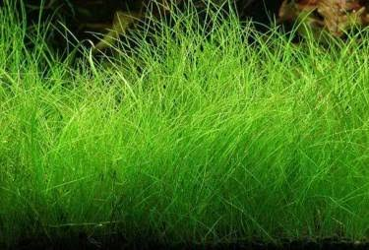
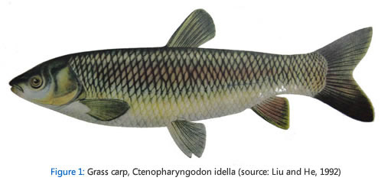
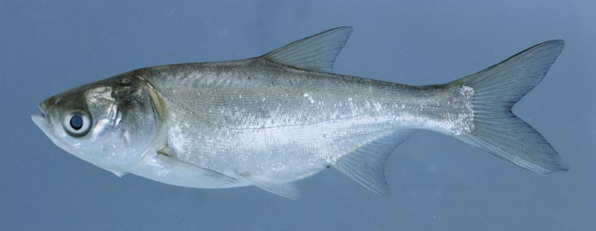
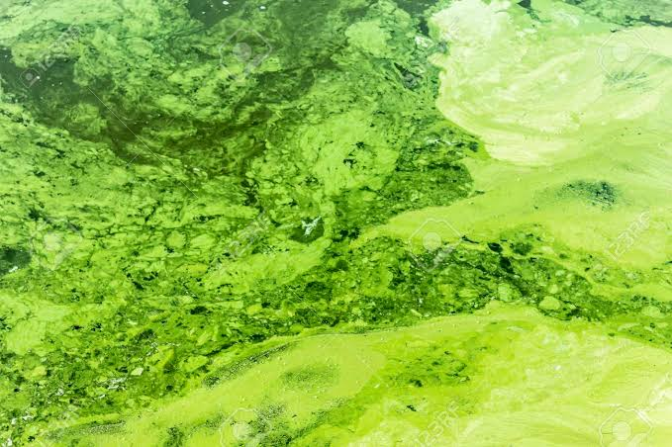
Improvement of Wild Stocks
The motives - establishment of new food fishes, filling “vacant niches,” stocking natural waters, providing forage for predators, restoration of fisheries, establishment of a wild stock, control of stunted species etc.
Eg. Introduction of grass carp or common carp to convert primary production into meat by utilising the macrophytic or phytoplanktonic organisms.
Silver carp- introduced -curb -excessive growth of blooms.
This kind of fish associations refers to polyculture of fish farming practices which can be extended to management of small water bodies and for extensive fish culture.
Increased meat production

Slide 14
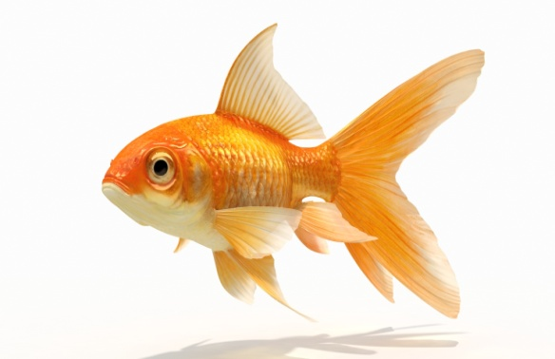
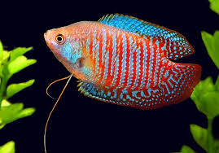
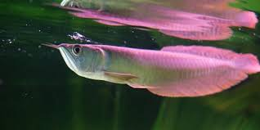
ORNAMENTAL PURPOSE
exotic fish -introduced worldwide- the global demand on colourful fishes and increase in aquarium trade for keeping aquarium in homes and working places.
Large species like goldfish are introduced for stocking into natural waters or ornamental ponds.
In the other way, innumerable species of small, mostly tropical fish have been widely dispersed by the flourishing aquarium trade.
Gold fish
Gourami
Arowana

Slide 15
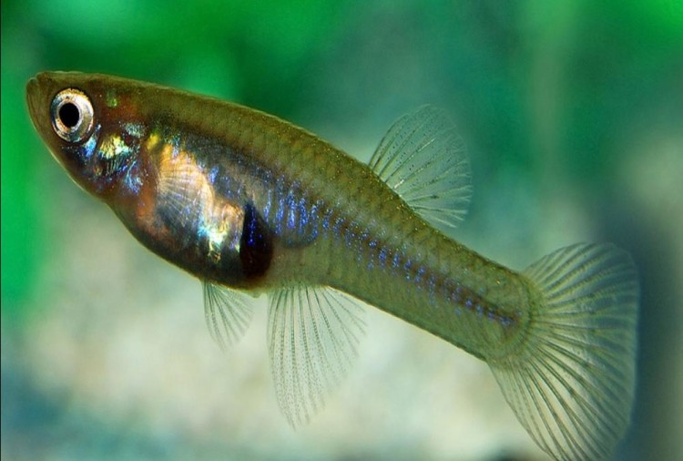
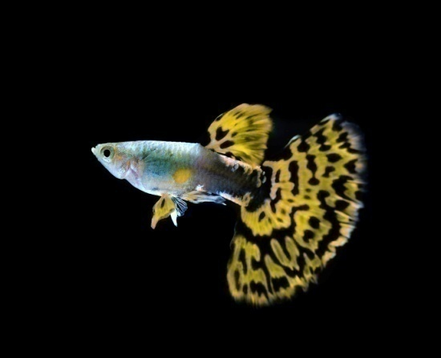
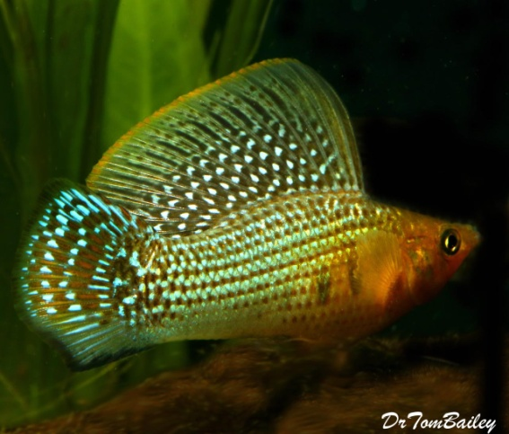
BIOLOGICAL CONTROL
In early 1920s- attempts were made by introducing exotic fish species- eradicate mosquito larvae- controlling malaria.
12 species have been introduced for mosquito control, but most extensive introductions were made with 3 species: Poecilia latipinna, Poecilia reticulata and Gambusia affinis.
Control of mosquito -larvivorous fish- effective and was replacing the more costly and environmentally harmful control with insecticides.
Besides this, in some cases molluskivorous fishes were introduced for controlling the aquatic snail vector of schistosomiasis.
Gambusia
Guppy
Sailfin molly

Slide 16
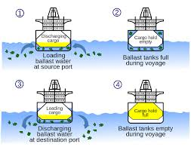
ACCIDENTAL INTRODUCTIONS
Ballast water- seawater or fresh water pumped into ballast tanks for stabilising the ship and is a major source of accidental introduction.
The water- different areas- pumped into the ballast- voyage of the ship, which may carry many plants and animals of the different region from where it is carried.
About one third of the aquatic species in the Great Lakes of North America are reported to have been introduced with the ballast water.

Slide 17
Historical perspectives and status of exotic fish species in Indian aquaculture
Species | Reason | Year | Source | From | Present status
Salmo trutta fario L. (Brown trout) | For planting in reservoirs and lakes | 1863 | England | Nilgiris (Tamil Nadu (TN)), Harwan in Kashmir (J&K), Kerala | Cultivated and bred in most of the hill states. Naturalized population exists in upland rivers, streams and lakes
 |  | 1908, | Japan
S. levensis Pickens (Leven trout) | -do- | 1863 | England | Nilgiris (TN) | Limited occurrence mostly in TN
Onchorhynchus mykiss Walbaum (Rainbow trout) | -do- | 1909 | Sri Lanka, Germany, New Zealand | -do- | Widely cultivated and bred in most of the hill states. Some are found in the wild
S. Gairdneri irideus Ranae (Steelhead trout) | -do- | 1867 | Europe | Nilgiris (TN), Kashmir, Kerala | Limited occurrence
 |  | 1940 | England and Sri Lanka

Slide 18
S. Gairdneri shasta Ranae (Steelhead trout) | For planting in reservoirs and lakes | 1941 | England | Kerala | Limited occurrence
Salvelinus fontinalis Mitchill 1814 (Brook trout) | -do- | 1959, 2007 | Canada | -do- | Aquaculture of this species is now practiced in Himachal Pradesh
Salvelinus namaykush Walbaum 1972 (Splake trout) | -do- | 1968 | Japan | Nilgiris (TN) | Limited occurrence
Onchorhynchus nerka Walbaum (Sockeye salmon) | -do- | 1968, 1970 | Canada | -do- | Limited occurrence
S. salar Linnaeus (Atlantic salmon) | -do- | 1968 | North America | Kashmir | Limited occurrence

Slide 19
Carassius carassius L. (Golden carp ⁄ crusian carp) | Game fishery | 1974 | England | Nilgiri waters (TN) | Present at most freshwater farms. Some are also available in natural waters
C. auratus L. (Gold carp) | -do- | 1974 | England | Ooty lake and Nilgiri waters (TN) | -do-
Tinca tinca L. (Tench) | -do- | 1870 | England | -do- | Present in the states of TN, Kanataka, HP, J&K and Uttarakhand
Osphronemus gourami Lacepede (Gourami) | -do- | 1856 | Java | Kolkata, West Bengal (WB) | Present at most freshwater farms. Some are available in natural waters
Puntius gonionotus Bleeker 1850 (Tawes) | -do- | 1972 | Indonesia | West Bengal and Orissa | Cultured mostly in WB, Orissa and Andaman and Nicobar and are available in natural waters
Oreochromis mossambicus Peters (Mozambique tilapia) | -do- | 1952 | Sri Lanka | West Bengal, (Mandapam, TN) (Jaisamund Lake) Rajasthan | Natural population of the cultured species exists in rivers and reservoirs

Slide 20
O. Urolepis urolepis Norman, 1922 (wami tilapia) | Aquaculture | Not known |  | Coastal waters of Andaman and Nicobar | Under aquaculture in Andaman and Nicobar
Cyprinus carpio communis L. (common carp) | Aquaculture | 1939 | Sri Lanka | Cuttack | Widely cultivated. It is available in rivers, lakes and reservoirs
 |  | 1957 | Bangkok
C. Carpio specularis Lacepede (Mirror carp) | -do- | 1939 | Sri Lanka | Nilgiris, TN | Under aquaculture in hill states and are available in natural waters
 |  | 1957 | Bangkok
C. carpio Bloch (Leather carp) | -do- | 1939 | Sri Lanka | Cuttack, Orissa | Under aquaculture in hill states and are available in natural waters
 |  | 1957 | Bangkok
Ctenopharyngodon idella Val. (Grass carp) | -do- | 1959, Japan, Hong Kong |  | Cuttack, Orissa | Widely cultured and are available in natural waters
Hypophthalmichthys molitrix Val. (Silver carp) | -do- | 1959, Japan, Hong Kong |  | -do- | Widely cultured and some are available in natural waters

Slide 21
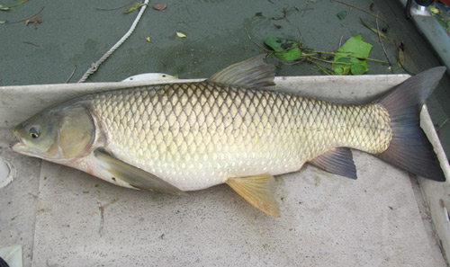
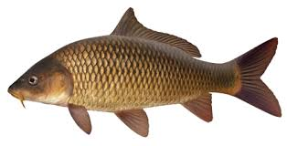
THE BENEFICIAL IMPACTS OF EXOTIC FISHES
Fast growth rate
The exotic carps- fast growth rate and high FCR,-become good candidates for the composite fish culture practice.
Contribute- greater share to the yield and can solve the scarcity of protein in India.
Grass carp has been reported to have attained a weight of 5 kg in a year.
Easy breeding and seed production
Common carp- breed in confined waters of pond and thus, the farmers need not go to the rivers for their seed collection during the breeding season.
Grass carp
Common carp

Slide 22
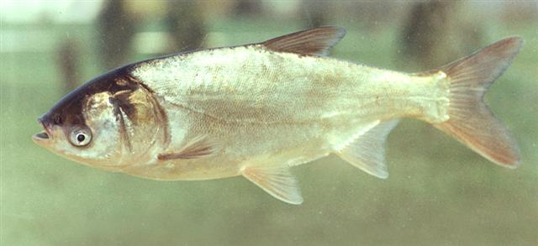
Cleaning of pond water and soil
Common carp -omnivorous and a scavenger- keeps the water of an impoundment (pond) clean and pollution-free.
Early maturity
Silver carp -age of 5-6 years in its native habitat. However,in Indian warmer condition it matures at the age of one.
Control of algal bloom
Silver carp -ability to utilise the dense bloom of phytoplankton and help in keeping it under check.
Control of aquatic weed
Grass carp can feed on a wide range of aquatic vegetation and is used for controlling of weeds.
Silver carp
Fertilization of pond water
Excreta -grass carp- semidigested food -serves as food for omnivorous fishes and also serves in fertilising the pond water.

Slide 23
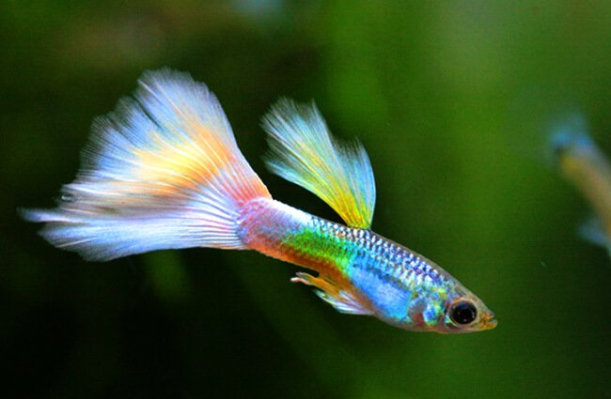
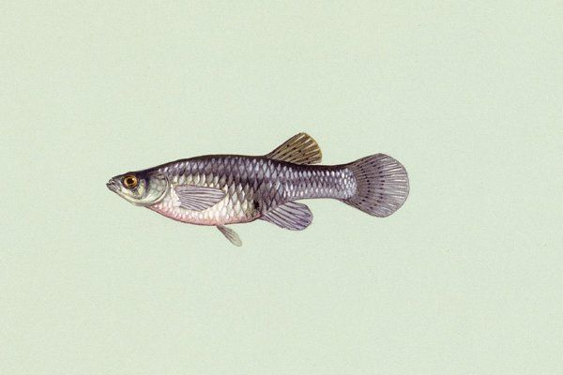
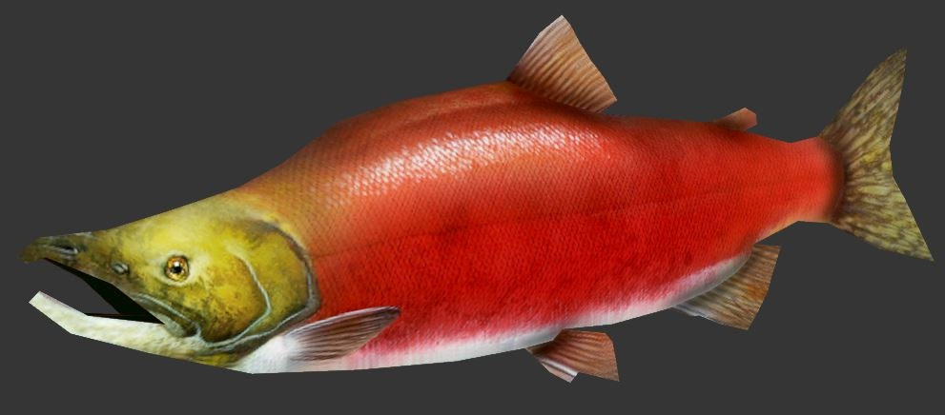
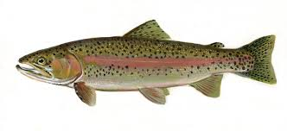
(8) Ornamental purpose
About 288 species of beautifully coloured exotic ornamental fishes are very popular among the aquarists.
(9) Control of mosquito larvae
The larvicidal fishes (Guppy, Gambusia affinis) have been introduced for mosquito control.
Guppy
(10) Serves as ideal species for game fishing
The game fishes (trout and salmon) have been planted in hill streams, lakes and reservoirs for leisure time angling.
Gambusia
Sockeye salmon
Rainbow trout

Slide 24
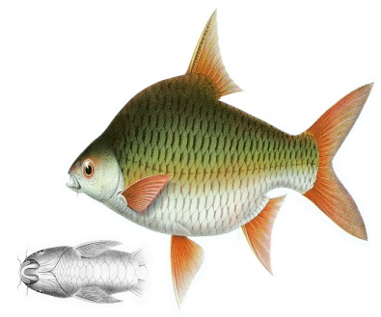
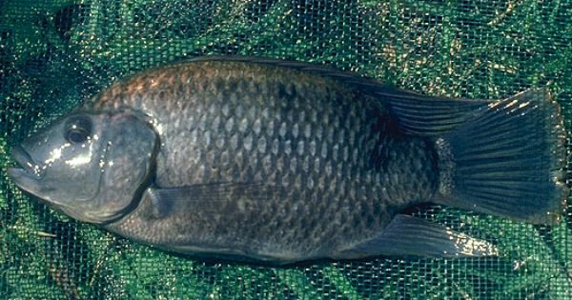
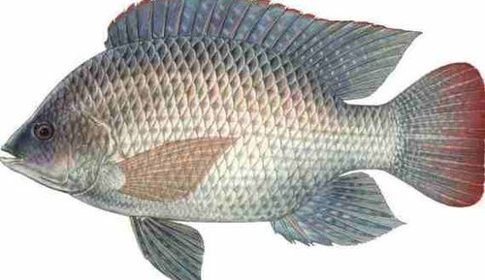
(11) Compatibility with agro-ecosystems
Puntius javonicus was unauthorisedly introduced in India for culturing in rice fields.
(12) Hardy nature and suitable for sewage fed fish culture
Tilapia- ‘super-fish’- ‘chicken of water’, breeds easily- high fecundity- cheap to feed- wide range of temperature and salinity.
Comparatively free from parasites and diseases. Due to their hardy nature they are ideally suited for culture in sewage- fed ponds.
(13) Less management and wide food acceptance
Tilapia- less management for culture as they can feed on a wide range of food, attain maturity within 2 months, can breed in confined waters and have good parental care.
Puntius
Wami tilapia
Nile tilapia

Slide 25
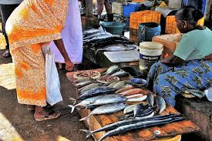
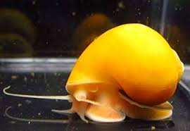
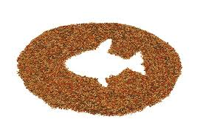
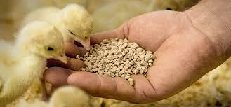
(14) Source of alternative income and Foreign exchange earning
Via sale of table fish and seeds
(15) Improves livelihood of people
Poor people -afford to buy exotic fishes due to relatively lower market price to culture them, improved nutrition of poor, improved income, employment opportunities.
(16) Serves as protein source of animal and fish feed
Golden snail has become a major protein source of animal/ fish feeds. Poor people can collect 10-15 kg/ day and sell to the feed companies.

Slide 26
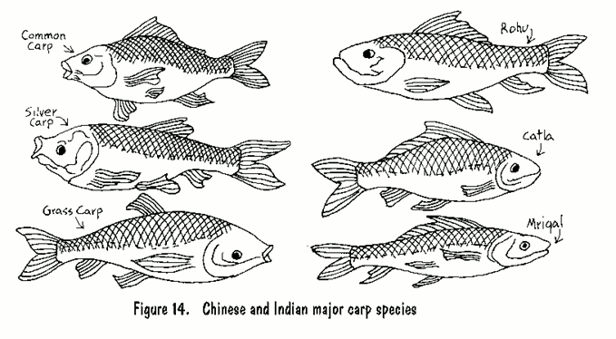
(17) Improve production and economic benefits from fisheries and aquaculture
Approximately 17% of the world’s finfish production is due to exotic species. Some countries are very dependent on the cultivation of non-native species. Yields of exotics exceeds 25% of the total harvest in China, 60% of the freshwater harvest in the Philippines, and 50% of the production in Brazil.
(18) Serves as ideal species for composite fish culture
Composite fish culture comprises of three exotic carps i.e. silver carp, grass carp and common carp together with three Indian major carps such as rohu, catla and mrigal.

Slide 27
GENERAL IMPACTS OF INTRODUCTION OF EXOTIC AQUATIC ORGANISMS
1. Interactions Between Native and Exotic Species
Considering- direct interactions- between introduced and endemic species- introduced organisms- alter trophic relationships- in 2 different ways.

Slide 28
First, their presence may significantly increase the number of prey available to native predators.
The case- Lake Kootenay of Canada- introduction of a certain variety of shrimp Mysis relicta -entailed a change- feeding regime of Oncorhynchus nerka, which, as a consequence of its shrimp consumption, proliferated more quickly than Oncorhynchus mykiss.
Secondly, the feeding habits of introduced fish can reduce the amount of natural food available to native species through a dietary overlap or competition.

Slide 29

COMPETITION
Feeding habits- introduced fish- reduce- amount of natural food available- native species- dietary overlap or competition.
Competition- not limited to trophic interactions- also to such other ecological limiting factors such as breeding space etc.
Russia- a number of fishes- accidentally introduced together- with Ctenopharyngodon idella-decline in local species with same feeding regime through superior growth and fecundity.
Sport fishes-Indian waters- considered- non-problematic- present- trouts- reported- compete with native stocks- found- major predator on the eggs and young ones of native species.

Slide 30
STUNTING
Stunting – process- the population- species expands rapidly- producing large numbers of individuals- mature and breed at a much reduced size- thus considerably reducing its recreational or commercial value.

Slide 31






FISHES SHOWING STUNTED GROWTH
Carassius auratus
Lepomis cyanellus
L. gibbosus
O. mossambicus
O. niloticus
Tilapia rendalli

Slide 32


ALTERATION OF HABITAT
Consumption- plant material- herbivorous fishes and -uprooting of macrophytes through digging for food- or for nesting sites and the organic enrichment- increases turbidity- thus reduces light penetration and photosynthesis - can result in displacement of aquatic vegetation.
Common carp- habit of rooting around in the bottom easily makes the water muddy.
This shades out macrophytes- disturbs benthic invertebrates and through the more rapid recycling of phosphate contributes to accelerated eutrophication.

Slide 33

GENETIC DETERIORATION
Direct impacts include those that operate on a species by initiating changes in gene flow, through hybridization and introgression.
Indirect effects are primarily those caused by inadequate number of spawners, either through release of a small number of individuals, or in the indigenous species through ecological processes such as competition, predation, new diseases or parasites.
Such genetic effects may lead to a loss of locally adapted populations and genetic diversity.

Slide 34
Presence of hybrids in aquaculture and their productions (FAO, 2012)
Sl. No. | Hybrids under Aquaculture | Country | Production(tones)
1 | Blue & Nile tilapia hybrid (Oreochromis aureus × O. Niloticus) | China and Panama | 333300
2 | Clarias catfish hybrid (Clariusgariepinus × C. Macrocephalus ) | Thailand, Bangladesh Nepal, India | 116900
3 | Tambacu hybrid (Clarius mesopotamicus ×Colossoma macropomum) | Brazil, Vietnam, Peru, Bangladesh | 21600
4 | Tambatinga hybrid (Colossomamacropomum × Piaractusbrachypomus ) | Brazil and Bangladesh | 4900
5 | Stripped bass hybrid (Moronechrysops× M. Saxatilis ) | US, Italy and Israel | 4200
6 | Splake Trout (hybrid between lake trout and brook trout) | Jammu & Kashmir | Not known
7 | Hybrids of bighead & Silver carp (A. Nobilis × H. Molotrix) | Bangladesh, Nepal, India | Not known

Slide 35


INTRODUCTION OF PARASITES, PATHOGENS, AND DISEASES
Importation of parasites, pathogens and diseases -via introduced fish- even those not intended for release.
Nematode parasites of the genus Anguillicola have been introduced into Europe with eels, Anguilla spp., intended for human consumption and not for stocking into natural waters. Nevertheless, the nematode escaped and has spread rapidly through the waters of Northern Europe.
Another example -introduced through fish- not intended to be stocked or cultivated -direct human consumption purposes concerns -Infectious Haematopoietic Necrosis -un-gutted Pacific salmon carcasses in France during the eighties.
Anguillicola
WSSV

Slide 36
Some of the exotic parasites which got established in Indian waters
North American fathead minnow -Yersinia ruckeri, -to parts of Northern Europe- due to uncontrolled shipments.
WSSV- believed to have been transmitted through seed brought to India clandestinely from Southeast Asian countries, where the virus has been amplified before as reported by certain authors (Shankar and Mohan, 1998).
Parasite species | Host | Record
Tripartiella copiosa | C. carpio | Das and Haldar (1987)
T. obtusa | C. idella | Das and Haldar (1987)
Trichodina nigra | O. mosssambicus | Mukherjee and Haldar (1982)
T. reticulata | H. molitrix | Mishra and Das (1995)
Neoergasilus japonicus | C. idella | Das and Haldar (1988)

Slide 37
IMPARTMENT OF GROWTH OF NATIVE SPECIES
Being a prolific breeder and hardy in nature, Tilapia has overcrowded many water bodies, resulting in prevention of growth of IMC in pond waters.
EFFECT IN FISH FAUNA
Introduction of Tilapia -Bharathapuzha (the longest river in Kerala) –resulted- replacing native fish fauna in many areas.
It has also been reported that frequent gill net fishing to collect Tilapias have resulted in disappearance of freshwater turtles in certain water bodies.
The introduction of C.carpio into Dal lake and Loktak lake has affected the indigenous fish population.

Slide 38
CAUSE TURBIDITY OF POND WATER
Common carp -sucking food organisms in the mud on the pond bottom and margins- water muddy and weakens the base of the pond dyke-resulting in erosion.
For making the pond water muddy, C. carpio has been considered by anglers as a pest in sport waters.
LOW COST AND POOR FLESH QUALITY
In India the culture of exotic carps is uneconomical due to its low cost.
The flesh of these fishes are poor in quality or have undesirable grass-smell in case of grass carp.

Slide 39


PROLIFIC BREEDING
Guppy and Mosquito Fish (Gambusia)- India -negative impact on aquatic biodiversity.
Mosquito Fish -hardy and prolific breeders, -capable of entering into the microhabitats of rare native species -reported as predators.
The famous Ichthyologist Mayer (1965) labelled Gambusia as a “fish destroyer”
IUCN (1986) has also reported that the cause of extinction of a number of species worldwide has been due to introduction of Gambusia.

Slide 40



VORACIOUS FEEDING HABIT
The fishes illegally imported to India consist of the carnivorous and voracious feeders such as the Big-head Carp and the African Catfish and the aquarium fish, the Red Piranha (Serrasalmus nattereri).
These fishes are reported to consume the eggs and larvae of native fish fauna and are the reason of extinction of several native species.
Big head carp
African catfish
Red piranha

Slide 41
RECOMMENDATIONS
Information on the biology of exotic species and their probable impact on the indigenous biodiversity has to be evaluated on a pilot scale before listing as probable for introduction.
Strict quarantine before entry into a new country/ region.
Dominantly herbivore species should get preference in selection for culture.
Indigenous species should be preferred for stocking and given similar treatments as given to exotics.
The term “trash fish” in polyculture should be dropped. They should be included in the production system and not belittled.
Filling environment, because of the absence of similar desirable species in the locality transplantation.

Slide 42
Not accompanying with pest, parasites or diseases such as “ulcerative syndrome” which might attack native species.
Introduction of new exotic species should be strictly controlled and exotics already introduced should only be used for pond culture.
High risk species such as grass carp, common carp and African catfish should not be stocked in the natural water bodies.
Enhance public awareness on potential negative impacts of these species.
Conduct research to evaluate negative impacts of already introduced exotic species and socio economic benefit of using native and less risk exotic species.
Develop culture technique for indigenous species.
Should develop appropriate policies management tools taking both positive and negative impacts into account.
Strengthen the manpower and build the capacity for implementing policies and regulations.
Code of conduct for exotic species (import and their use) should be developed

Slide 43
REGULATIONS ON USE OF EXOTIC SPECIES
Important agreements- WTO is the Sanitary and Phytosanitary measures.
The SPS agreement specifies that measures should be applied only to the extent necessary to protect human and plant life or health.
SPS agreement- standards, guidelines and recommendations developed by Office International des Epizooties (OIE), the World Organization for Animal Health, which provides an international benchmark.
ICAR, NBFGR, NFDB, etc. taking a statewise and nation wise approach respectively.
To finally involving major intergovernmental agencies like FAO, NACA, World Fisheries centre, ICES, etc. to coordinate, monitor and manage the transfers and introduction of species on international level .

Slide 44
The American fisheries society protocol consist of the following steps:
RATIONALE
SEARCH
PRELIMINARY ASSESSMENT OF THE IMPACTS
PUBLICITY AND REVIEWS
EXPERIMENTAL RESEARCH
EVALUATION AND RECOMMENDATION
INTRODUCTION

Slide 45
Illegal and unauthorised culture of exotic fish species in India
Species | Reason | Year | Source | Place | Present status | Remarks
Oreochromis niloticus L. (Nile tilapia) | Aquaculture | 1987 | Thailand and Israel | Tamil Nadu, West Bengal, Rajasthan | Commercial culture production in Andhra Pradesh. Natural population exists in rivers and reservoirs | Government considered its regulated culture owing to increased demand. Adverse impact perceived
Tilapia zilli Gervais, 1848 (Red belly tilapia) | Aquatic weed control in irrigation systems | 1986 | Thailand | Indira Gandhi Canal, Rajasthan | Present in freshwater farms in addition to the Indira Gandhi Canal in Rajasthan | Impact not perceived, but introduction was unnecessary

Slide 46
Aristichthys nobils Richard (Bighead) | Aquaculture | 1980 | Bangladesh and Nepal | West Bengal | Widely cultivated and some are present in natural waters | A banned species in aquaculture. Significant adverse impact perceived
Ictalurus punctatus Rafinesque, 1818 (Channel catfish) | -do- | 1990 |  | Thanjavur (TN) West Bengal | Limited occurrence | Unauthorized trials were not successful
Clarias gariepinus Burch. 1822 (African catfish) | -do- | Possibly 1994 |  | West Bengal | Widely cultured and some are present in natural waters | A banned species in aquaculture. Significant adverse impact perceived

Slide 47
Pangasianodon hypophthalmus Sauvage (Sutchi catfish) | Aquaculture and aquarium purpose | Possibly 1997 |  | West Bengal | Cultured mostly in coastal states. Some are present in natural waters | Some adverse ecological impact perceived. However, government considered its regulated culture
Mylopharyngodon piceus Richardson (Black carp) | Aquaculture and mollusk control | Possibly 2005 from Bangladesh |  | 24ºN Parganas of West Bengal | Present mainly in West Bengal and have now spread throughout north India | Limited culture and impact not perceived
Myliopharyngodon idella Richardson (Mud carp) | Aquaculture | Possibly 2005 | Bangladesh | 24ºN Parganas of West Bengal | Limited occurrence | Limited culture and impact not perceived

Slide 48
Piaractus brachypomus Cuvier 1818 (Pacu) | Aquaculture and aquarium purpose | Possibly in 2004 | Bangladesh | West Bengal | Large-scale breeding in West Bengal and distributed in AP, Kerala, north-eastern region. | Used for both the aquaculture and aquarium trade
Litopaeneus vannamai Boone 1931 (White leg shrimp) | Aquaculture | 2001 | Thailand | Andhra Pradesh, Tamil Nadu | Under aquaculture mostly in Andhra Pradesh | Government has now considered its culture under bio-security

Slide 49
POSITIVE AND NEGATIVE IMPACTS OF SOME EXOTIC FISHES
SPECIES | COUNTRY/ PLACE | POSITIVE IMPACTS | NEGATIVE IMPACT | REFERENCE
Carassius carassius (gold fish) | Thailand |  | Used for aquaculture, beneficial for culture practices | Welcomme and Vidthayanon, 2000
Cirrhinus cirrhosus (mrigal) | Thailand | Used for aquaculture, beneficial for culture practices |  | Welcomme and Vidthayanon, 2000
Clarius gariepinus (African catfish) | Vietnam | Used for aquaculture | Hybridization with Clarius macrocephalus | Welcomme and Vidthayanon, 2000
Ctenopharyngodon idella (Grass carp) | Thailand | Used for aquaculture, have consumer preference, control of invasive aquatic vegetation |  | Welcomme and Vidthayanon, 2000
Cyprinus carpio (common carp) | Thailand | Aquaculture with low management | Eating the eggs of other species, muddying the water, | Welcomme and Vidthayanon, 2000

Slide 50
SPECIES | COUNTRY/ PLACE | POSITIVE IMPACTS | NEGATIVE IMPACT | REFERENCE
Gambusia affinis (mosquito fish) | Mekong River Basin | Mosquito control | Habit of eating larvae and eggs of other fish | Welcomme and Vidthayanon, 2000
Catla catla (Catla) | Vietnam | Aquaculture |  | Welcomme and Vidthayanon, 2000
Silver carp | India (Himachal Pradesh ) |  | Indian major carp population in the reservoir which is dominated by silver carp | Raman et al., 2013
Common carp | Ganga River System |  | Abundantly available in Ganga river system and affect the population of native fish fauna | Raman et al., 2013
Clarius gariepinus | India |  | Highly predatory for other fish and larvae, threaten wildlife. | Raman et al., 2013
Pangasianodon hypothalamus | India | High growth and authorized production | Introduction of exotic pathogen and parasites | Raman et al., 2013
Gambusia affinis | India | Control of insect larvae, prevention from Maleria | Cause ecological imbalance due to its voracious feeding habits. | Raman et al., 2013

Slide 51
SPECIES | COUNTRY/ PLACE | POSITIVE IMPACTS | NEGATIVE IMPACT | REFERENCE
Litopenaeus vannamei | India | High production and market value | Susceptible to many deadly pathogens like TSV. | Raman et al., 2013
Aristichthys nobilis | India |  | Threat to smaller indigenous fishes and invertebrates. | Raman et al., 2013
European carp, Cyprinus carpio and gold fish | Australia |  | Hybridization | De Silva, 1989
European carp | Australia |  | Habitat alteration | De Silva, 1989
Brown trout, Chinook salmon, Onchorynchus tshawytscha, redfin (Perca fluviatilis) | Australia |  | Predation on endemic fish and larvae | De Silva, 1989
Snakeskin gourami | Malaysia | Considered as a good species for culture in rice fields |  | De Silva, 1989
Pearl spot | Malaysia | Aquaculture | Do not cause such impacts | De Silva, 1989
Black bass | Malaysia |  | Occupy the lakes in some areas | De Silva, 1989

Slide 52
SPECIES | COUNTRY/ PLACE | POSITIVE IMPACTS | NEGATIVE IMPACT | REFERENCE
Terrapin | Singapore | Chinese soft shell terrapin farming is lucrative in Singapore | Faster reproduction, voracious feeder, occupy some of the reservoirs | De Silva, 1989
Leptobarbus hoevenii | Taiwan | Mass production is easy therefore it is preferred by many aquaculturist |  | De Silva, 1989
Melanobrama amblycephala | Taiwan | It has been used for cross breeding with the Ctenopharyngodon idellus |  | De Silva, 1989
Red drum | Taiwan | Aquaculture |  | De Silva, 1989
Macrobrachium rosenbergii | Taiwan | Cultured as monoculture, popular species for game fishing in Taiwan |  | De Silva, 1989
Penaeus stylirostris | Taiwan | Cultured for consumption |  | De Silva, 1989

Slide 53
SPECIES | COUNTRY/ PLACE | POSITIVE IMPACTS | NEGATIVE IMPACT | REFERENCE
P. brasiliensis | Taiwan | Aquaculture |  | De Silva, 1989
P. schmitti | Taiwan | Culture |  | De Silva, 1989
Achatina fulica | Taiwan |  | This species has propagated and has become a pest to agriculture | De Silva, 1989
Ampullarius insularum | Taiwan |  | Cause widespread damage to rice fields | De Silva, 1989

Slide 54
REFERENCE
Bhat, B. V. and Tarun, K. S. 2014. Introduction of exotic aquatic species for aquaculture in india: some perspectives. Aquaculture: New Possibilities and Concerns, Pages 157–172. Narendra Publishing House, Delhi, India.
Das, M.K. and Haldar, D.P. 1988. Parasitofauna of cultures exotic carps in India, its bioecological significance, Workshop on Exotic Aquatic sp. In India, Asian Fish. Soc., 25­26 April : 39 pp.
De Silva S.S. (ed.), 1989. Exotic Aquatic Organisms in Asia. Asian Fish. Soc. Spec. Pub. 3, Manila, Philippines.
De Silva S.S., Nguyen, Thuy T.T., Turchini GM, Amarasinghe U.S. and Abery N.W. 2009. Alien species in aquaculture and biodiversity: a paradox in food production. Ambio, 38: 24–28.
FAO, 2005 to 2013. Fisheries and Aquaculture topics. Database on Introductions of Aquatic Species (DIAS). Topics Fact Sheets. Text by Devin Bartley. In: FAO Fisheries and Aquaculture Department [online]. Rome. http://www.fao.org/fishery/topic/14786/en
Lakra W. S., Singh A. K., Mahanta P. C. (Eds.) 2009. Fish Genetic Resources. Narendra Publishing House, New Delhi, India, 284pp.
Lakra W.S., Singh, A.K. and Ayyappan, S. (eds). 2008. Fish Introduction in India: Status, Potential and Challenges. Narendra Publishers, New Delhi.

Slide 55
Raman, R. P., Arvind, M., Sanjeevan, Kumar., Soni, S., Manoj, N. B., and Saurav Kumar. 2013. Introductions of exotic fish species into indian waters: an overview of benefits, impacts, issues and management. Adv Fish Res., 6: 1–14.
Shelton W. L. and Shmuel R. 2006. Exotic species in global aquaculture - a review. Isr. J. Aquacult. – Bamid. 58(1): 3-28.
Singh A.K. and Lakra, W. S. 2011. Risk and benefit assessment of alien fish species of the aquaculture and aquarium trade into India. Rev. Aquacult. 3: 3–18.
Singh, A.K. 2014. Emerging alien species in Indian aquaculture: prospects and threats. J. Aquat. Biol. & Fish. 2(1): 32-41.
Singh, A.K. and Lakra, W.S. 2006. Impact of alien ﬁsh species in India: emerging scenario. J. Ecophysiol.Occupational Health 6 (3–4): 165–174.
Welcomme, R. and C. Vidthayanon, 2000. The impacts of introductions and stocking of exotic fish species in the Mekong basin and policies for their control. Management of Reservoir Fisheries in the Mekong Basin, MRC. Vientiane. 70 pp.
Whittington, R.J. and Chong, R. 2007 Global trade in ornamental ﬁsh from an Australian perspective: the case for revised import risk analysis and management strategies. Preventive Veterinary Medicine 81 (1–3): 92–116.

Slide 56


