Slide 1
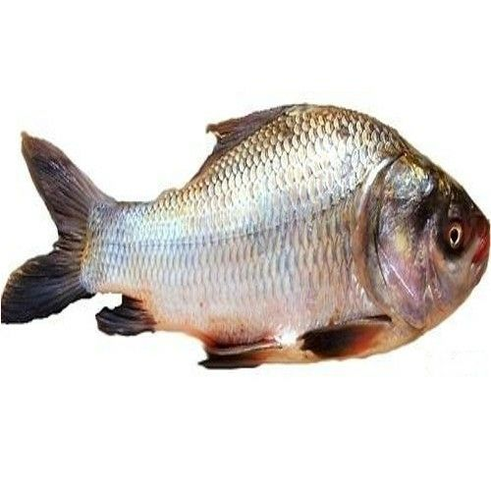
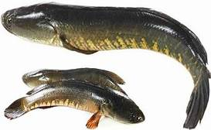


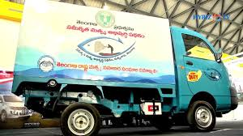
Present scenario of inland fisheries schemes in Telangana State
SHETTY SHIVA SHANKER
U-18-TN-03-002-M-F-023 (FEX)
DEPARTMENT OF FISHERIES EXTENSION, ECONOMICS & STATISTICS
FISHERIES COLLEGE & RESEARCH INSTITUTE
THOOTHUKUDI-628008

Slide 2
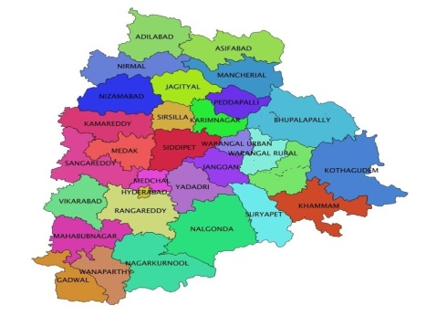
Introduction
Telangana is the 29th state of India, formed on 2nd of June 2014
The state has an area of 1,14,840 Sq. Km and has a population of 3,52,86,757.
Fisheries is one of the most important traditional occupation and is providing livelihood to around 5 lakh families
The sector is contributing 0.6 percent to the GSDP.
It plays an important role in the overall socio-economic development of fisher families in Telangana by providing nutrition & food security.
Aquaculture is in more than 1000 ha area.

Slide 3
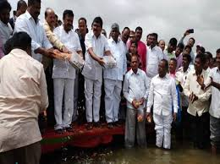

Resources
Type of water resource | Nos | Water spread Area
Reservoirs | 77 | 1,67,914 Ha
Tanks vested with Fisheries Department | 4,647 | 3,04,160 Ha
Total vested with Gram Panchayats | 19,465 | 1,00,093 Ha
Total | 24,189 | 5,72,167 Ha

Slide 4


Telangana is a inland state with about 5.73lakh ha wsa .It stands 3rd in wsa &6th in inland fish production.3.5 lakh tonnes fish production in 2018
It has been observed that there is a tremendous increase in fisheries sector in terms of production, consumption &marketing from past five years.
By implementation of IFDS and BLUE REVOLUTION welfare schemes to fish farmers a holistic development of the sector has been observed by free supply of fish seed and other components which improve the socio-economic and livelihood status fish farmers in Telangana state.
Fish production in the state is estimated to be 195,000 (MT) in 2016-2017 ,at present 2018-19 its crossed 3.5 lakh tonnes by 2020 its estimated to be 4 lakh tonnes in fish production .

Slide 5
Budget allotted for implementation of schemes in Telangana
(IFDS)Integrated Fisheries Developmet Scheme
1000 crore)
IFDS:1000 cr :80cr from NCDC +200 cr Telangana state
(BRS)Blue revolution
20 crores

Slide 6

Blue revolution(Neel kranti)
The Blue Revolution in India was launched during the 7th Five Year Plan (1985-1990) during the sponsorship of the Fish Farmers Development Agency (FFDA) by the Central Government of India. Later, during the 8th Five Year Plan (1992-97) .
The Neel Kranti Mission, 2016 (NKM 16), being the year in which the Vision has been given by the Prime Minister will have multi-dimensional approach to all activities concerned with development of the fisheries sector as modern world class industry in India.
This scheme focused on the development and management of fisheries controlled by the National Fisheries Development Board (NFDB).

Slide 7
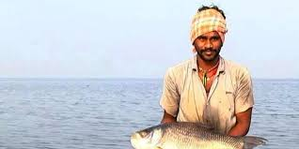
Vision
Creating an enabling environment for integrated development of the full potential of fisheries of the country, along with substantially improvement in the income status of fishers and fish farmers keeping in view the sustainability, bio-security and environmental concerns.
The structured plan scheme on Blue Revolution-Integrated Development and Management of Fisheries has been approved at a total central outlay of Rs 3000 cr. Budget allotment for Telangana is around Rs 20 Cr for the duration (2015-16 to 2019-2020)

Slide 8

Objectives
1
To fully tap the total fish potential of the country both in the inland and the marine sector and triple the production by 2020.
To transform the fisheries sector as a modern industry with special focus on new technologies and processes
2
To double the income of the fishers and fish farmers with special focus on increasing productivity and better marketing postharvest technologies.
To ensure inclusive participation of the fishers and fish farmers in the income enhancement
3
To triple the export earnings by 2020 with focus on benefits flow to the fishers and fish farmers including through institutional mechanisms in the cooperative, producer companies and other structures
To enhance food and nutritional security of the country

Slide 9
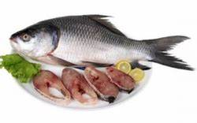
Achievements of Blue revolution in Telangana
Blue Revolution -2016-17: Grounding of all the components sanctioned has been completed except establishment of Brood bank which is under progress. So far for Rs. 1212.50 Lakhs has been submitted to Govt. of India.
Blue Revolution -2017-18: Govt. of India has given approval for an amount of Rs. 1960.53 Lakhs for 6 components. The total financial assistance is Rs. 878.13 Lakhs, Central share is Rs. 533.09 Lakhs, State share is Rs.345.04 Lakhs and beneficiary contribution is Rs. 1082.40 lakh
The GoI has released 90% of Central share ie., Rs. 479.78 Lakhs. An amount of Rs. 713.29 Lakhs including State share is released to (25) Districts for grounding the schemes. The implementation is under progress. The UC for an amount of Rs.147. 86 Lakhs is submitted to Government of India
Blue Revolution -2018-19: Government of India has given approval for an amount of Rs.13865.40 Lakhs for 13 components.
The total financial assistance/subsidy is Rs.6365.40Lakhs in which Central Share is Rs. 3751.24 Lakhs, State share is Rs. 2614.16 Lakhs and Beneficiary contribution is Rs. 7500.00 Lakhs.
. The GoI has released 1st instalment of Rs. 1574.80 Lakhs which is not yet released to the department. The identification of beneficiaries is under progress.

Slide 10
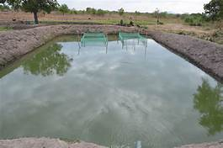
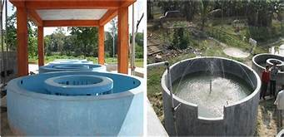
Component units of blue revolution
1.Construction of fish ponds:
Grounding units :88
Budget:252.8 lakhs
2.Establishment of freshwater fish seed hatcheries:
Units implemented :17
Budget :175 lakhs

Slide 11
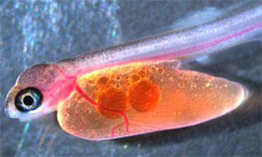
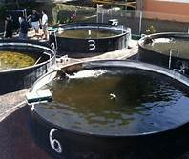
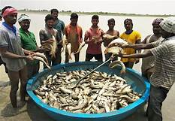
Components..
3. RAS (Re-circulatory aquaculture system):
Units:2
Budget :40 lakhs
4. Input cost for fish culture:
Units :88
Financial assistance:52.41 lakhs

Slide 12
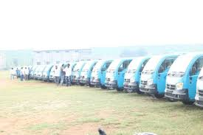
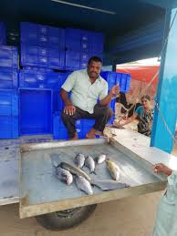
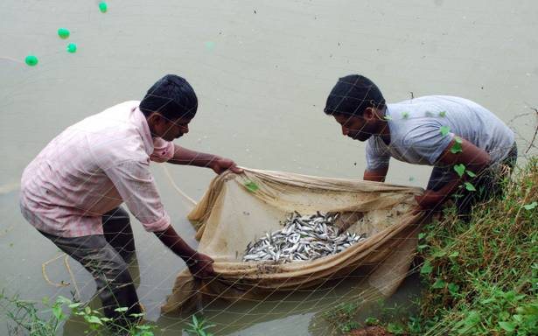
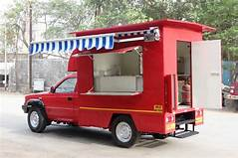
Components..
5. Seed rearing units :
Units :65
Amount sanctioned:38.61 lakhs
6. Mobile retail outlets
Units :25
Budget:73 lakhs

Slide 13
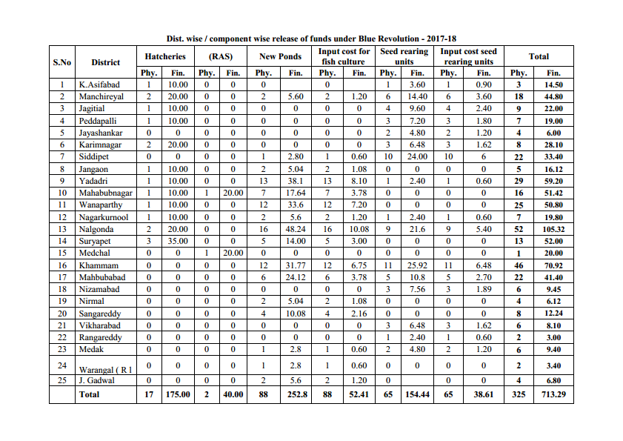
Grounding of components under blue revolution

Slide 14
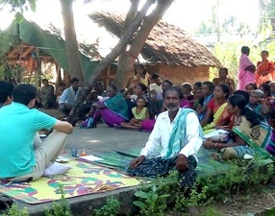
National Scheme for Welfare of Fishermen in Telangana
Pradhan Mantri Suraksha Bhima Yojana 1st June, 2017
Under this scheme 3, 11,956 numbers of active fishermen of age group 18-70 years are covered.
Accidental death/permanent disability :2.00 lakhs
Partial disability: Rs.1.00 lakh
Hospitalization expenses Rs. 10,000/- in the event of accident.
Government of India-National Federation of Fishermen Cooperatives-New Delhi-
The lives of the fishermen are insured by paying premium of Rs.12/- per fisher by the State and Central Govt. equally
Implementing agency of this scheme is FISHCOPFED –
Govt. of Telangana is also paying Rs. 4.00 lakh as ex-gratia
During the year 2018-19 an amount of Rs.18,71,736 is paid to FISHCOPFED for insuring 3,11,956 fishermen

Slide 15
Continue…
ii) Pradhan Mantri Jean Jyothi Bheema Yojana (PMJJBY):
Under this scheme, the sum assured is Rs.2.00 lakhs in the event of natural death. The scholarship is extended to two children @ Rs.2400/- per year from 9th to 12th Standard.
Fishermen of age group 18-50 years in the State have to pay premium of Rs.330/- per fishermen by the State and Central Govt. equally
The implementing agency of this scheme is FISHCOPFED and insured agency is Life Insurance Company.
The Govt. has released Rs. 247.00 Lakhs towards payment of insurance coverage. An amount of Rs. 2, 28, 78, 240/- is paid to FISHCOPFED through RTGS for insuring 1, 38,656 fishermen with effect from 1-6-2019.

Slide 16
Implementing agencies
Central Government Institutes/Agencies, NFDB, ICAR Institutes
State Governments and Union Territories
State Government Agencies, Organisations, Corporations, Federations, Boards, Panchayats and Local Urban Bodies
Fishers Cooperatives/Registered Fishers Bodies
Individual beneficiaries/fishers, Entrepreneurs, Scheduled Castes(SCs), Scheduled Tribes (STs) Groups, Women and their Co-operatives, SHG’s and Fish Farmers and miscellaneous Fishermen Bodies

Slide 17
OUTCOME
The Blue Revolution in Telangana along with the Fish Farmers Development Agency (FFDA) brought an improvement in the aquaculture and fisheries sector with the introduction of new techniques of rearing, marketing, exporting and fish breeding.
There is a rapid growth rate in terms of fish production in the state from 1,95,000(MT) to 3.5 lakh production in a span of 3 years
Installation of cages in reservoirs made the fish farmers to double their income in a short period of time
The Blue Revolution Scheme also encourages entrepreneurship development(feed mills), private investment (fish ponds), Public-Private Partnership (PPP) with fish farmers .

Slide 18

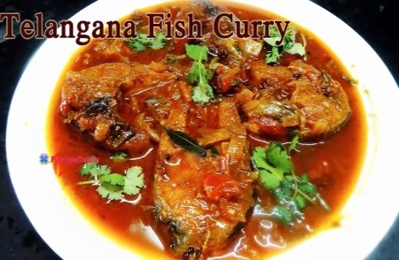
How far it is successful ??
From the past 5 years ,blue revolution scheme has contributed nearly 16 cr for various fisheries components under the financial assistance from Nfdb with the collaboration of state fisheries department.
Providing financial support to fishermen as an ex-gratia under national scheme for welfare of fishermen communities(group accident, partial disability)
Enhancing fish production in the state by Construction new fish ponds ,Hatcheries, Fish rearing unit ,Cage culture etc
Establishment of Fish canteens ,Retail fish outlets and fishermen community halls & fish markets create a income generation source to fisher families in Telangana

Slide 19
Is it beneficial to fishermen??
The Neel kranti mission (2016),made a holistic development of fish production by providing free supply of fish seed in Telangana State
Subsidy vehicles (mobile outlets, luggage auto)
Insurance scheme (PMSBY)(PMJJBY)
Financial assistance (Ponds, RAS & Cages )
Training and awareness programmes in fish production and consumption
So, Blue revolution scheme is enriching the socio- economic conditions and improving the livelihood status of fishermen in Telangana State

Slide 20
Centrally Sponsored Scheme on Blue Revolution Pattern of Financial Assistance
(I) Beneficiary Oriented Projects Funded by DADF, Govt. of India
APPROVED PROJECT COST SHARE
Category | Govt.assistance | Beneficiaries share | Total
General Category | 40% | 60% | 100%
SC/ ST/ Women & their Cooperatives | 60% | 40% | 100%
(B) Central & State Share of Govt. Assistance
Region | Central Share | State Share | Total
Other States | 60% | 40% | 100%
North East & Hilly States | 90% | 10% | 100%
Union Territories | 100% | 0% | 100%

Slide 21
CONTINUE…
(C) Project Cost Sharing Percentage
Region & Category of Beneficiaries | Govt. of India Share | State Govt. Share | Beneficiary Share | Total
Other States
General Category | 24% | 16% | 60% | 100%
SC/ ST/ Women & their Cooperatives | 36% | 24% | 40% | 100%
North East & Hilly States
General Category | 36% | 4% | 60% | 100%
SC/ ST/ Women & their Cooperatives | 54% | 6% | 40% | 100%
Union Territories
General Category | 40% | 0% | 60% | 100%
SC/ ST/ Women & their Cooperatives | 60% | 0% | 40% | 100%

Slide 22
CONTINUE..
Central & State Share
Region | Central/ NFDB Assistance | State / UT Share | Total
Other States | 50% | 50% | 100%
North East & Hilly States | 80% | 20% | 100%
Union Territories/ Govt. of India Organizations/ Institutes | 100% | 0% | 100%

Slide 23
Continue..
S. No | Name of the Project | Phy. | Fin.(Rs. in Lakhs
1 | Up gradation of Inland Fisheries Training Centre {IFTC) Warangal | 1 | 100.00
2 | Construction of Re-circulatory Aquaculture System (RAS) | 10 | 250.00
3 | Establishment of Fish Seed Rearing Ponds with input subsidy | 26 | 79.00
 | Total |  | 429.00

Slide 24
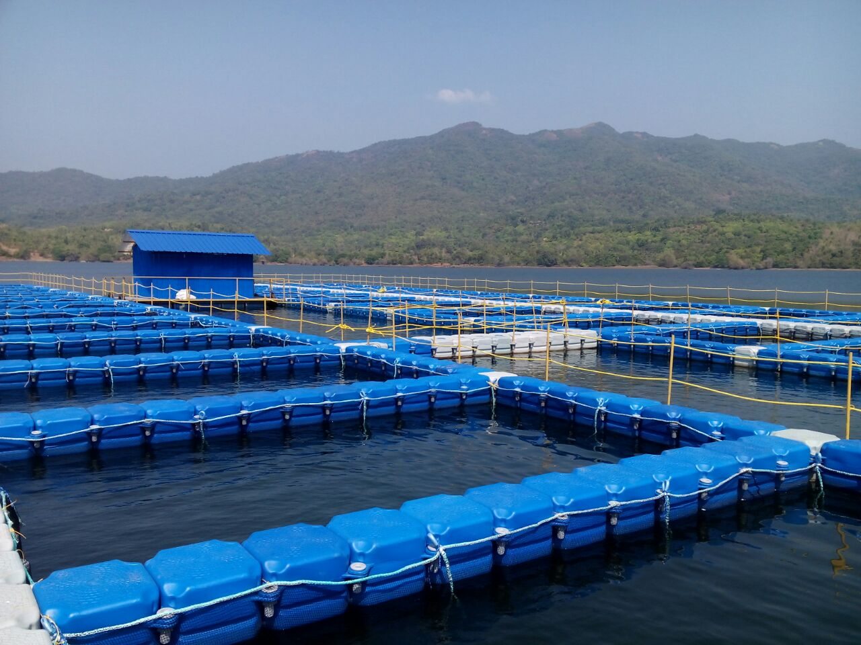
Promotion of cage culture in the State:
Under this initiative, 72 demo cages, 510 cages by fishermen Cooperative Societies & 160 cages by Private Entrepreneurs were installed.

Slide 25
Integrated Fisheries Development Scheme (IFDS)
(NCDC), has sanctioned Financial Assistance to Telangana St (TSFCOF), Hyderabad in 2017-18 for development of Fisheries Sector in Telangana State with an outlay of Rs.1000.00 crores for the benefit of members :
Primary Fishermen Cooperative Societies (PFCSs)
Fisherwomen co-operative Societies,
Fishermen Marketing Societies,
District Fishermen Co-operative Societies and TSFCOF in all 31 districts of Telangana State for implementation in two years.
Out of it 800 cr by central government and 200 cr by state government.

Slide 26
OBJECTIVES
Year-round fishing activity & supply of local fish in Telangana throughout the year.
Saturation approach in fish rearing in water bodies - Minor, Medium & Major Reservoirs.
Diversification of fish rearing activity by introducing cage culture, pond culture & prawn culture etc.
Every practicing Fisherman should enjoy improved livelihood & enhanced incomes.
Sustainability of Fisheries sector through increasing production and productivity by providing backward and forward linkages and achieving self- sufficiency in production of fish seed

Slide 27
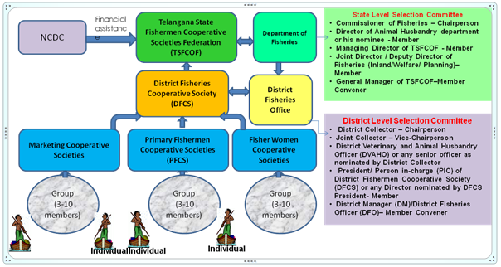
IFDS SELECTION PROCESS

Slide 28
Salient features of the scheme:
Scheme shall be implemented by TSFCOF and connected cooperatives in coordination with Department of Fisheries.
The scope of the scheme is to enhance the fish production, creation of infrastructure for fish seed production, processing and marketing and to develop trained / skilled manpower.
The benefits can be availed as a member of the society, group of members within a society, Society or District Fisheries Cooperative Society (DFCS) depending on the component.
Flexibility is provided in the unit cost and design of few components based on the need (Retail Fish Markets, Landing Centers, Training Centers and Pen Culture, etc) to be undertaken on 100% grant basis.
In case of other activities where subsidy and beneficiary contribution are involved, the activity shall be taken up based on technical & financial viability of the proposal and the capacity of the beneficiary to bear the beneficiary contribution.

Slide 29
Administrative Set up for implementation of the scheme
Appointing the District Fisheries Officer of all the Districts as District Managers:
(DFO) will be appointed as District Managers to TSFCOF for implementation of Scheme(IFDS) in the District.
Components wise online system-beneficiary contribution-individual-group-sociaty form
District collector monitor the DLSC and SLSC components-sanction orders-grounding of units
Department of Fisheries will provide departmental field staff .TSFCOF shall provide one data entry operator and computer to each district.
Administrative expenditure for implementation of scheme shall be met from Project funds earmarked for this purpose

Slide 30
DLSC (Roles and responsibilities)
District manager
Receive applications from FCS
Scrutinize the components received at district level
District collector
DLSC shall approve the eligible beneficiaries
issue administrative sanctions for the components
DLSC TO TSCOF
In case of Components cleared at State level it is forwarded to TSFCOF for eligibility.
Eligible applications exceeds the target given to the district. DLSC shall write to TSFCOF
Offline applications data entered into T-matsya

Slide 31
SLSC (Roles and responsibilities)
TSFCOF
TSFCOF Shall receive and evaluate the applications received from DLSC for components which are to be approved at state level.
SLSC approve the applications . Based on allocations, technicalities and fund availability
The Managing Director, TSFCOF issues administrative sanctions to the beneficiaries approved by the SLSC

Slide 32
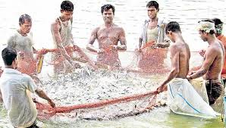
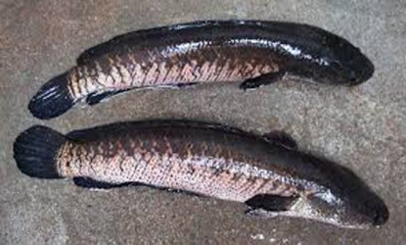
General Eligibility criteria for Member Societies:
They should be the members of Primary Fisheries Cooperative Societies (fcs)
The Members age should be 18 years and above.
The Member Societies should have completed audit up to 2016-17 for availing scheme during 2018-19.
The Members/ Group/ Member Societies should be willing to pay the beneficiary contribution as prescribed for availing schemes.
The Society shall not be a defaulter of any government dues (e.g., Lease amount, seed amount, etc
The individual beneficiaries who have availed subsidy for the same component under other schemes (like Blue Revolution, Development of Fisheries (Normal State Plan), NFDB, RKVY, etc.)
The members should be willing to undergo training programs organised by state government.

Slide 33
Procedure for Selection of Beneficiaries:
Extensive publicity shall be provided by the district administration to fcs about IFDS
Pamphlets &booklets Beneficiaries shall fill up the registration and submit to DM
Beneficiaries can apply from any MeeSeva centers,
e-laabh portal
Individual - group unit
SOCIATY.
No of applications is more than the number of allotted units, DM on behalf of DLSC shall write to TSFCOF .Approval and administrative sanction shall be issued
DLSC-scrutinize-SLSC-TSFCOF Issue the administrative sanction and communicate to the concerned districts for implementation.
No of applications is less than or equal to the number of allotted units for a district, all the eligible applicants shall be considered for approval.
online applications should submit print & photograph and relevant documents during the time of verification.
An individual beneficiary can apply for 4 small units or 1 large unit (luggage auto ,construction of ponds

Slide 34
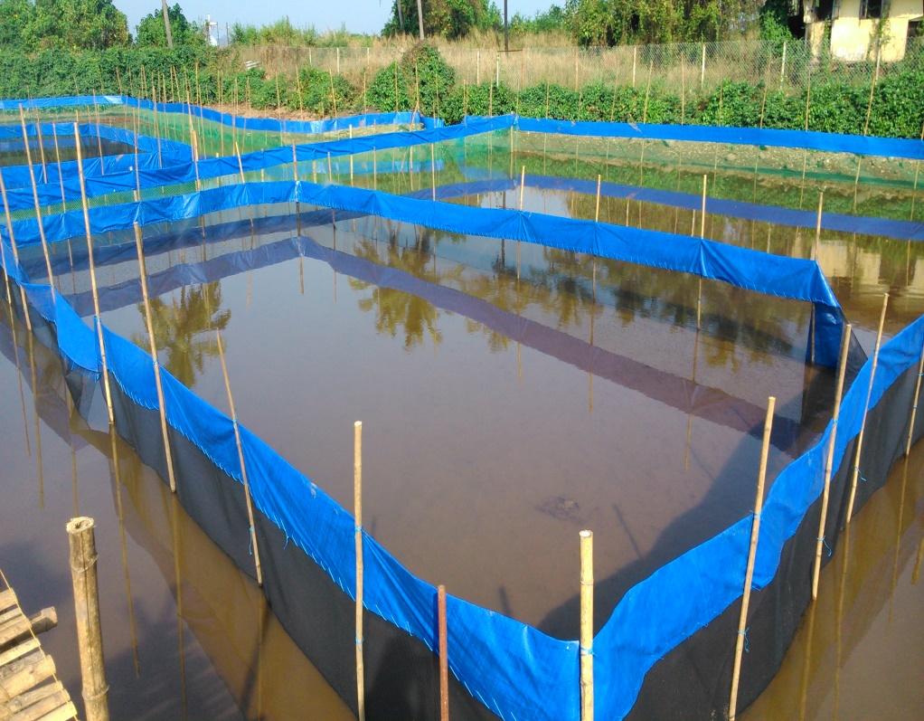
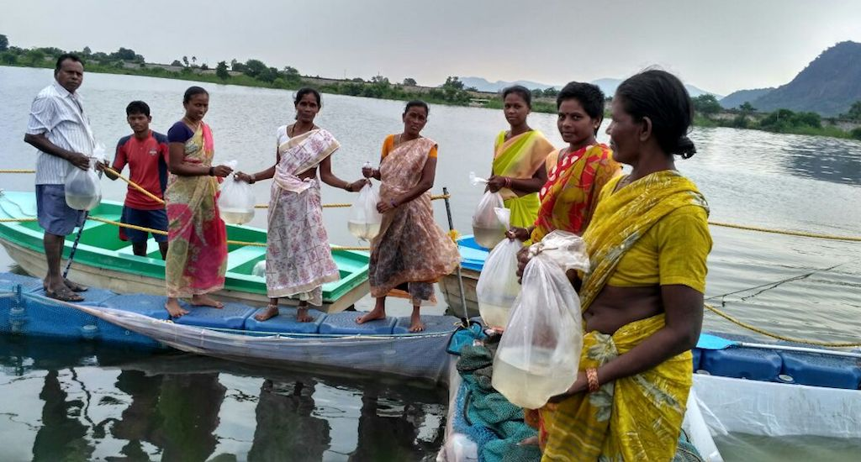
Components under IFDS
A.Enhancing Seed production:
1.Construction of fish seed rearing units:
Units allotted in state:200
Budget:1,500 lakhs
2.Captive rearing ponds:
Units :1150
Budget:8,625 lakhs

Slide 35
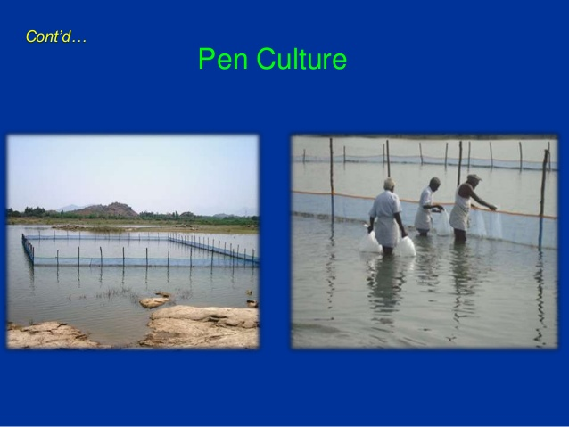
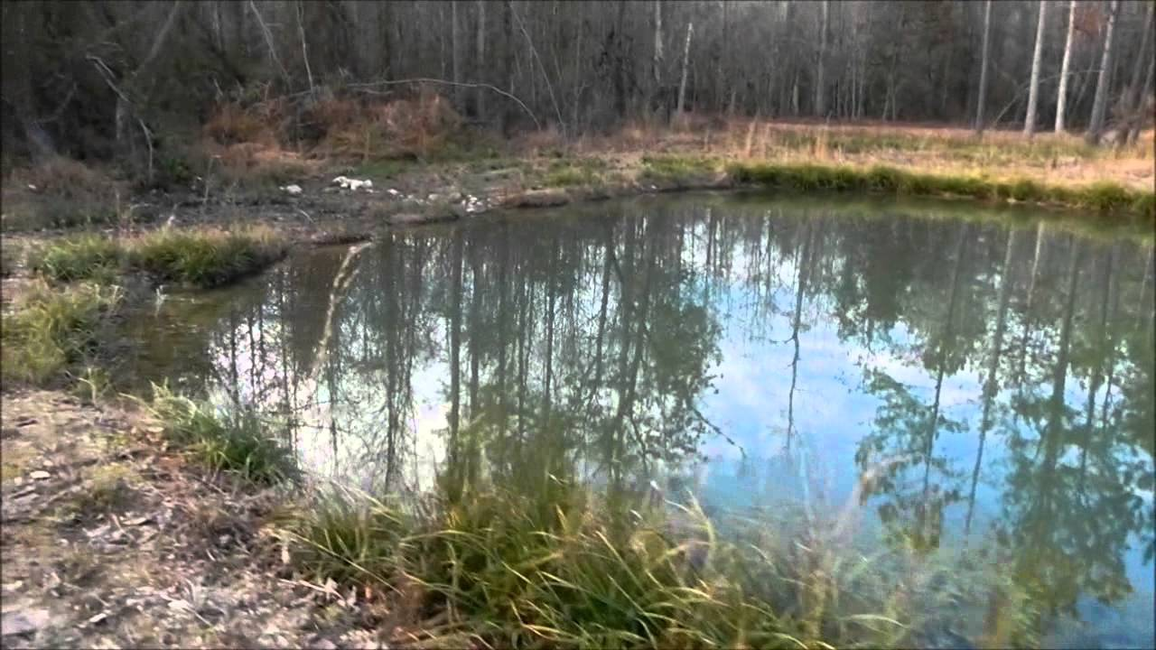
Components…
B. Enhancing fish production:
4.Construction of new fish ponds:
Units:400
Budget:3,400.0 lakhs
3.Pen culture:
Units alloted:200
Budget :100 lakhs

Slide 36
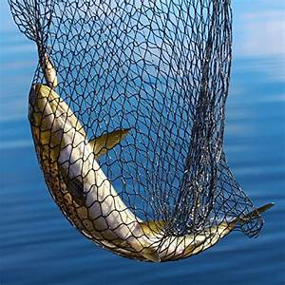
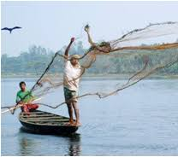
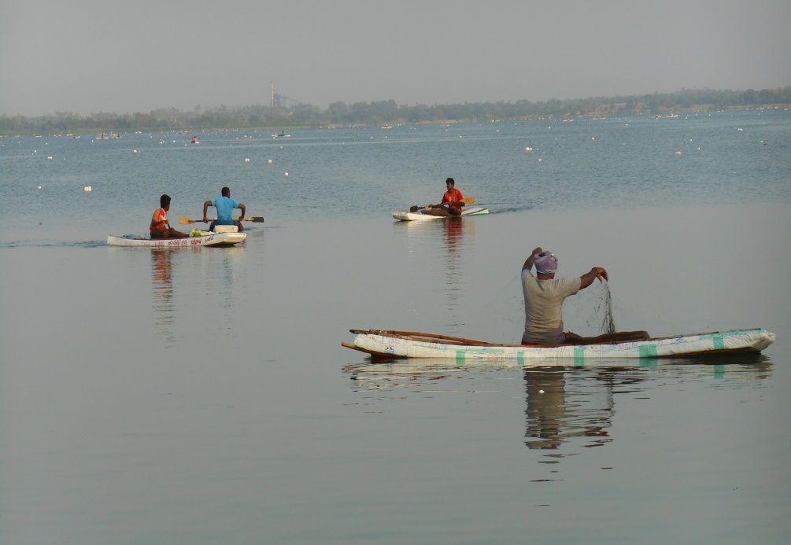
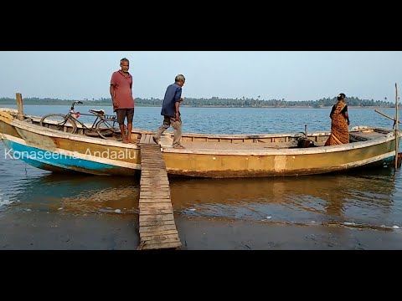
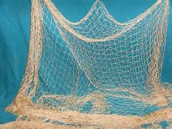
Continue…
5. Integrated Development of Reservoir fisheries:
Units:30
Budegt:6000.0 lakhs
C. Harvesting support:
6.Crafts and nets
Units:20000
Budget:4,000.0 lakhs

Slide 37
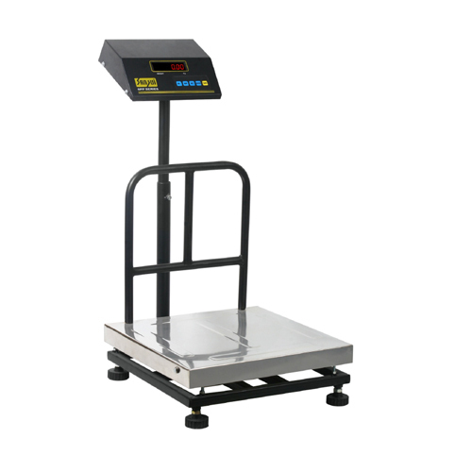
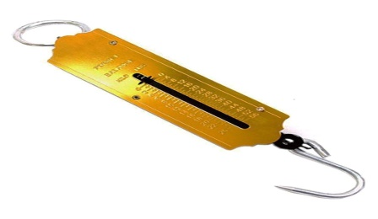
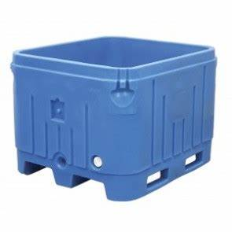
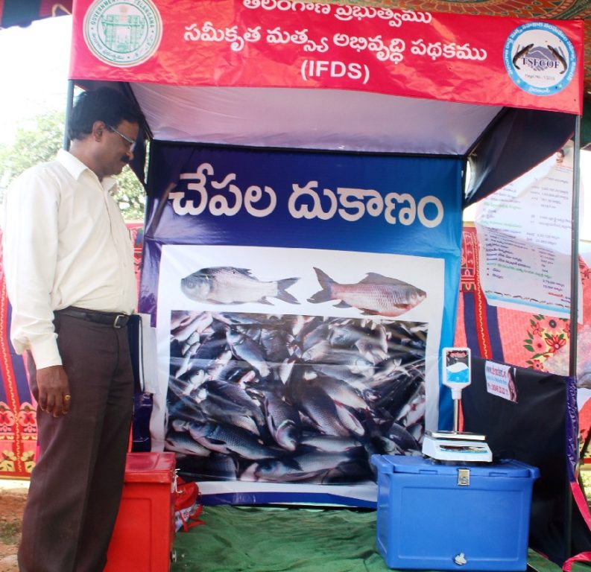
Marketing support
7.Plastic fish crates:
Units:25000
Budget:1000.0 lakhs :
8. Portable fish vending kiosks:
Units :4000
Budget:800.0 lakhs

Slide 38
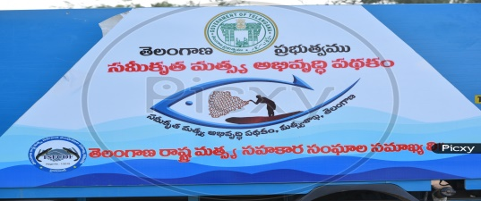
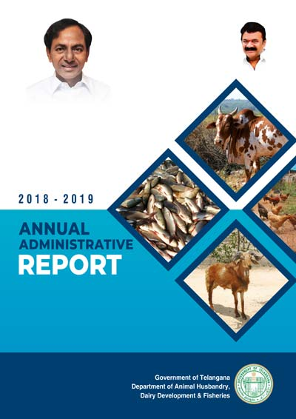
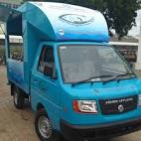
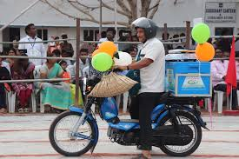
Components …
9.Mobile fish outlets:
Units :100
Budget:1510.0 lakhs
10.vending unit with moped:
Units:50000
Budget:25,000.0 lakhs

Slide 39
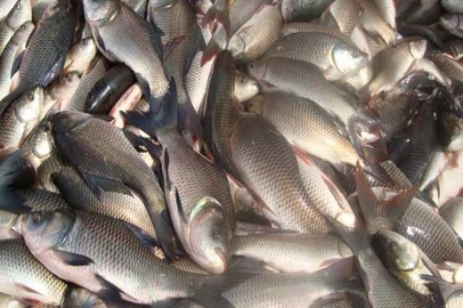
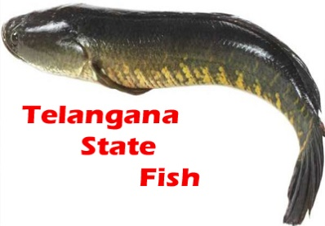
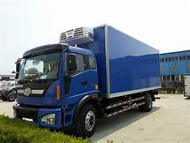
Marketing &Transport
11.Vending unit with Luggage Auto:
Units:1000
Budget:5.000.0 lakhs
12.Hygienic transport vehicle:
Units:200
Budget:2,000. lakhs

Slide 40
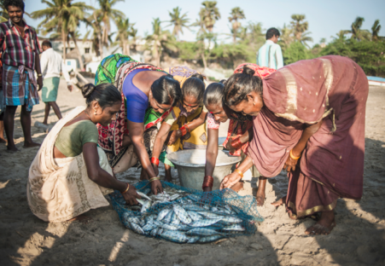
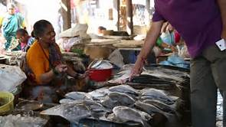
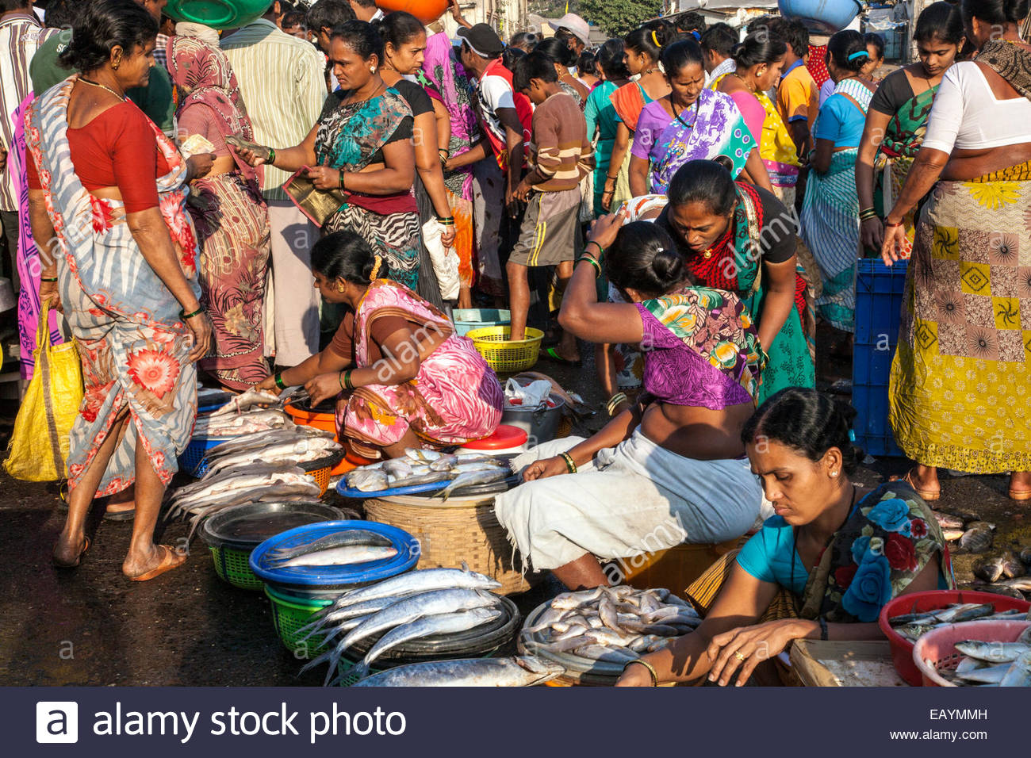
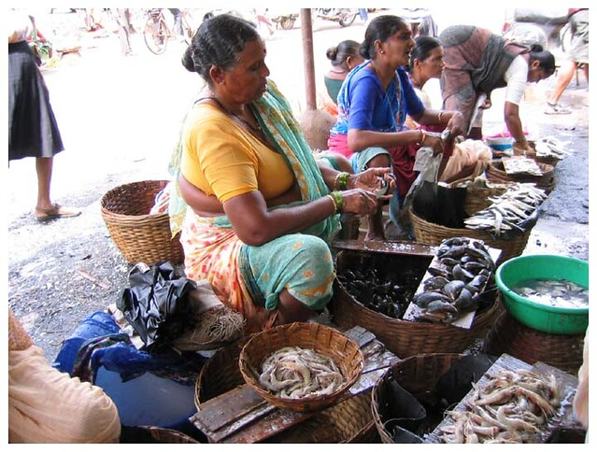
Marketing assistance
About 74 fwcs are present in Telangana state.
Developing marketing sector by constructing retail and whole sale markets .
Revolving fund :800.0 lakhs

Slide 41
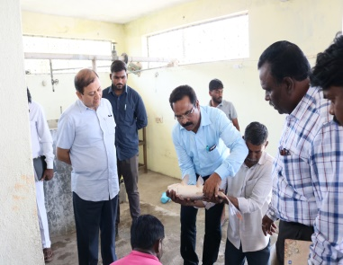
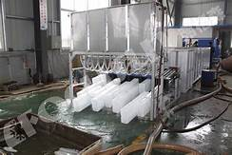
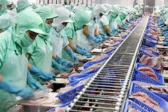

Infrastructure development projects
Construction of Retail fish markets :units 250&budget 2,500.0 lakhs
Each district about Rs .10 lakh is allotted for construction
Processing plants-SLSC-DPR-Layout –units-4
Ice plants(10 ton)-SLSC -DPR-Layout-50 unit
Fish feed mills
Net mending and putti fabrication units

Slide 42





Continue..
Aqua tourism units
Establishment of ornamental fish tanks
Construction of pellet feed plants
Innovative kiosks

Slide 43
Procurement & Fund Flow:
A scheme joint account shall be opened to be operated by the District Manager and District Collector. Initially certain amount of funds will be transferred to the scheme joint account for immediate grounding of scheme.
Once 80% of the funds already released are utilized, fund request shall be sent to TSFCOF as per requirement.

Slide 44
Supply of individual units to beneficiaries:
Beneficiaries shall be informed about the unit cost, , subsidy, beneficiary contribution by District Manager through Demand Draft-issue acknowledgement
Selection of vendors for individual units will be done at state level through Tender Process.
The District Manager shall place orders for the beneficiaries who have paid the contribution amount for their preferred units to the empanelled firm/ selected vendor.
Sanction shall be provided by the District Collector for release of total cost of the unit (beneficiary contribution plus subsidy) selected supplier as per the actual cost of the item
The cost of selected item exceeds by the beneficiary the unit cost, balance cost has to be borne by the beneficiary. . The units shall be procured from the authorized suppliers and distributed to the beneficiaries
Accessories for Vending units with mopeds, Vending units with luggage auto, Mobile Fish Outlet, Hygienic transport vehicle and Insulated trucks etc, the beneficiary can purchase the necessary items and submit the bills to avail subsidy as per eligibility

Slide 45
b. Construction of infrastructure by Government:
DLSC-executive agency -markets, landing centers, fish seed farms -Funds shall be released stage/ phase wise as per the progress of work to the executing agency.
Beneficiaries-hard copy-District Manager-relevant land document -The remaining documents like DPR / Layout / DLC permission shall be submitted within 30 days.
Beneficiaries-Savings bank-submitting the application form (Joint account for Group beneficiaries and existing Savings bank account can also be used for individual beneficiary/ society/ DFCS).
During scrutiny, the original documents shall be produced at the time of verification by the District Manager
Eligible beneficiaries-approval and sanction order shall be issued. They must produce other relevant documents after communication of administrative sanction.
At state level, the Managing Director, TSFCOF will coordinate and monitor the scheme as nodal officer.
Management Information System (MIS) will be put in place in due course of time to monitor the progress of implementation.
All measures shall be taken at the district level for ensuring the transparency, accountability and vigilance
The beneficiary must complete 50% of the work to claim 50% subsidy as 1st installment.
. Subsidy amount shall be released through online mode in two installments corresponding to the progress of work. (50% of subsidy as first installment after 50% of work done and remaining 50% of subsidy as second installment after completion of the work).

Slide 46
Monitoring:
At state level, the Managing Director, TSFCOF will coordinate and monitor the scheme as nodal officer.
T-matysa website to know ground level activities of components
Management Information System (MIS) will be put in place in due course of time to monitor the progress of implementation.
All measures shall be taken at the district level for ensuring the transparency, accountability and vigilance.

Slide 47



Grounding survey under IFDS ??
Nearly about 42,173 no of vending mopeds
1,829 Luggage autos
323 Mobile fish outlets
39 Hygienic transport vehicles
1,836 Nets
3,135 plastic fish crates
About 44,465 beneficiaries have benefited at a cost of about Rs .357.52 crores

Slide 48



Benefits ?
Marketing assistance increased to 3 to 5 lakhs to about 74 FWCS as Revolving fund
Construction of 3 Whole sale fish markets
2 Training centers
173 Fish food kiosks
9 insulated trucks
10 ornamental units
11 RAS units
9 Ice plants
5 small fish feed mills

Slide 49



How far its useful ??
By implementing these schemes the fisheries Economy, Exporting and production has been boost up by fishermen .
Generating a good employment opportunity of marketing fishes and fishery products by innovative projects
Consumption of fishes is highly noticed due to availability of fresh inland fishes
Women sociaties are getting priority in terms of marketing Revolving fund
Fishermen are practicing culture fisheries(Cages, Nursery ,Seed rearing ) instead capture fisheries

Slide 50
Advantages of IFDS to fishermen
Generating income source to FCS by providing 75% subsidy components
Encouraging them with their traditional occupation infrastructure equipment's (crafts & nets )
Marketing ,fish production and exporting make easier to fishermen by providing vehicles
Construction of( ponds, rearing units ) and providing training on fish breeding makes fish farmers to produce their own hatchery seed
Providing a special training on (Net mending )(Putti Fabrication) gives additional knowledge to fish farmers
Installation of Cages in reservoirs leads to higher production if inland fishes in a short period of time

Slide 51


Innovative achievement
Recently fwcs in Telangana state have developed a project called “Telangana Ruchulu ‘’ a innovative item in value addition
Fish canteen stalls are launched in metro areas where different varieties fish and fishery products (fish biryani, curry&fry )
RAS system fish production

Slide 52
Agenda of IFDS
To double the production and utilization of natural inland resources of the state
To develop fishermen communities by small scale fishing activities (RAS, Transportation &marketing sector)
To improve the consumption of fish in the state
To develop fisheries infrastructure & reservoirs

Slide 53
A Few Drawbacks of IFDS in extension activities
Due to lack awareness about the schemes .
Training activities
Quality of seed
Less awareness meetings
Less exposure visits

Slide 54


Outcome of IFDS
Nearly about 4000 fishermen sociaties and 74 fwcs are getting benefit through this scheme
Supply of subsidy vehicles and other components to around 3 lakh members in the state would improve their economic condition and generating employment opportunities to fishermen communities
By implementing this scheme ,there is a tremendous increase in fish production in inland tanks and reservoirs by free supply of fish seed
Construction of new fish ponds, hatcheries ,rearing tanks &RAS system will enhance better production and marketing system in Telangana state

Slide 55

Conclusion
Both IFDS and blue revolution has created a tremendous achievement in fisheries sector of Telangana state
Encouraging the traditional occupation of fishermen their ability in fishing activities and skills can improve standard of living
Implementing new possible methods and techniques in fish culture and innovative projects make inland fish production and marketing to a greater level can be able to set as ‘’Bangaru Telangana ‘’
Grant free supply of fish seed is the most initiative step of schemes in better production in inland sector
To improve the economic-welfare condition of fishermen sociaties , schemes are necessary for their development
Government of Telangana should take initiatve steps in developing fisheries sector &FCS by implementing better schemes in near future

Slide 56

Thank you

